Slide 1
Hardware Acceleration for
Spatial Databases:
Building Next-Gen. Query Engines with Ray Tracing Cores
Rubao Lee, Liang Geng, Xiaodong Zhang
The Ohio State University, USA

Slide 2
Chapter 0: Introduction
Chapter 1: Ray-tracing Meets Spatial Databases
Chapter 2: Ray-tracing Fundamentals
Chapter 3: RT for Spatial Join
Chapter 4: RT for Spatial Indexing
Chapter 5: RT for Spatial Functions (Case Study: Hausdorff Distance)
Chapter 6: RT in Action: Integrating RT into SedonaDB
Conclusion: Summary & Key Takeaways
Content

Slide 3
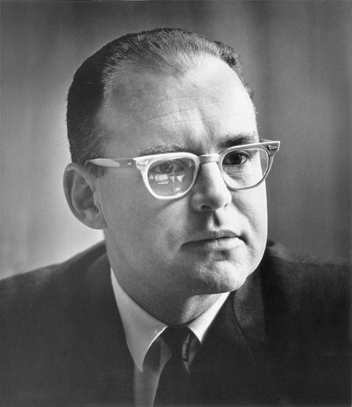

Ending of the Era of Moore’s and Denard’s Scaling Laws
“The number of transistors incorporated in a chip will be doubled every 24 months”
  Gordon Moore, 1978 (based on his observation in 1965)
“We can keep power consumption constant as the number of transistors increases in a chip”
  Robert Dennard, 1974 (this scaling ended in 2005)

Slide 4
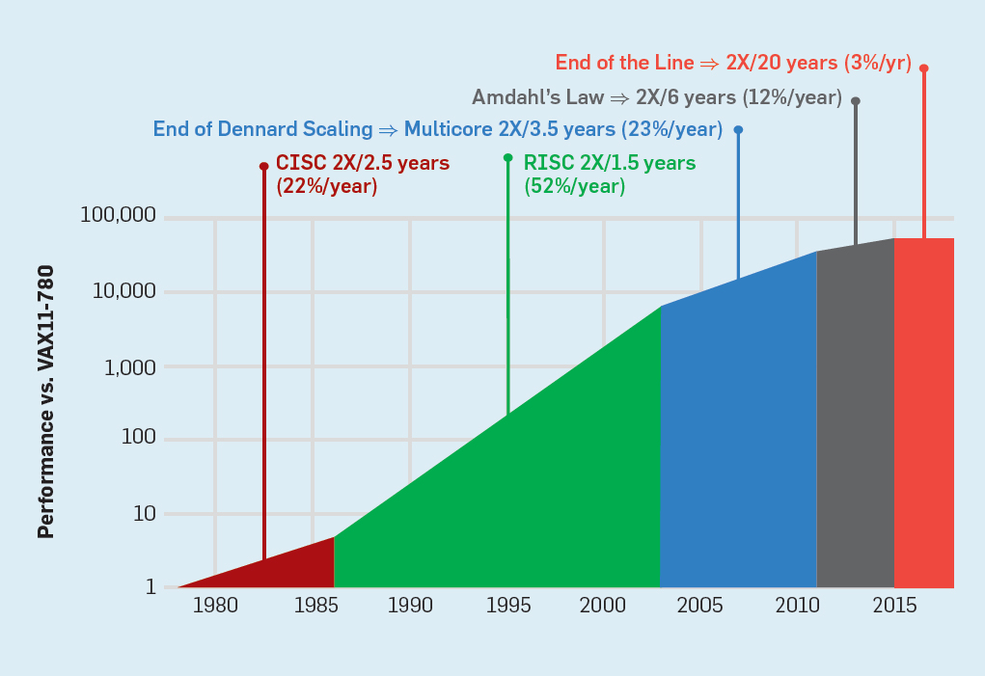
CPU Speed Growth Driven by the Two Laws Stopped
Since 2015, the growth rate has been almost 0.

Slide 5
A Powerful and General-Purpose Computing Ecosystem
A simple and one-size-fits-all computing abstraction
  Any computing task is expressed by programs and executed by ISA
  A task is divided by a sequence of standard execution time unit (stamps)
  Under multiprogramming model, OS assigns time units to each task
  Data blocks are moved up and down in the memory hierarchy
  Programming is simple-English-based and architecture/OS independent
  This abstraction helps users in all domains without formal CS training
Moore’s law has a hidden dark side in the ecosystem
  Efficiency has become increasingly low in both power and performance
  Non-inclusive to other executions, e.g., SIMT, data flow, and domain specific

Slide 6
General-Purpose Ecosystem Hits its Performance Limit
CPU and Multicores
  Standard programming and general-purpose for all applications
  Power/performance efficiency are increasingly low
GPUs (graphics processing unit)
  Highly Efficient for applications with high SIMT parallelism
  Not efficient for branch divergence, irregular memory accesses, and others
FPGAs (field programmable gate arrays)
  High energy efficiency
  Low clock rate, limited on-chip memory and bandwidth and others
ASICs (application specific integrated circuits)
  Very efficient for targeted applications by customized chips
  Specialized programming and domain-focused
  General-Purpose
  Efficiency

Slide 7
Continued HPC can only be Achieved by Hardware Acceleration
Hardware Acceleration
  The computing device is a custom-designed chip for a targeted application, achieving superior performance and energy efficiency
  Examples include AI accelerators, Cryptography devices, Networking processors, many ASIC blocks in iPhone, and others
In this Tutorial
  We study how a spatial database is accelerated by Ray Tracing Cores
  Ray Tracing Core is originally designed for ray-tracing rendering in graphics
  You will learn how this device is effectively used in Spatial Databases

Slide 8


Introducing Two Excellent Lecturers of the Tutorial
Liang Geng
  A Graduating Ph.D. at Ohio State University, a Presidential Graduate Fellow
  Besides many publications, he also has multiple years’ industry experience
  He is presenting a paper on RT-accelerated SedonaDB in VLDB 2026
Rubao Lee
  My colleague in the CSE Department at Ohio State
  A database expert
  His work on scaling databases on cluster of computers has been recognized by VLDB Test of Time Award, ICDCS Best Paper Award, and Faculty Research Award at Ohio State

Slide 9
Chapter 0: Introduction
Chapter 1: Ray-tracing Meets Spatial Databases
Chapter 2: Ray-tracing Fundamentals
Chapter 3: RT for Spatial Join
Chapter 4: RT for Spatial Indexing
Chapter 5: RT for Spatial Functions (Case Study: Hausdorff Distance)
Chapter 6: RT in Action: Integrating RT into SedonaDB
Conclusion: Summary & Key Takeaways
Content

Slide 10
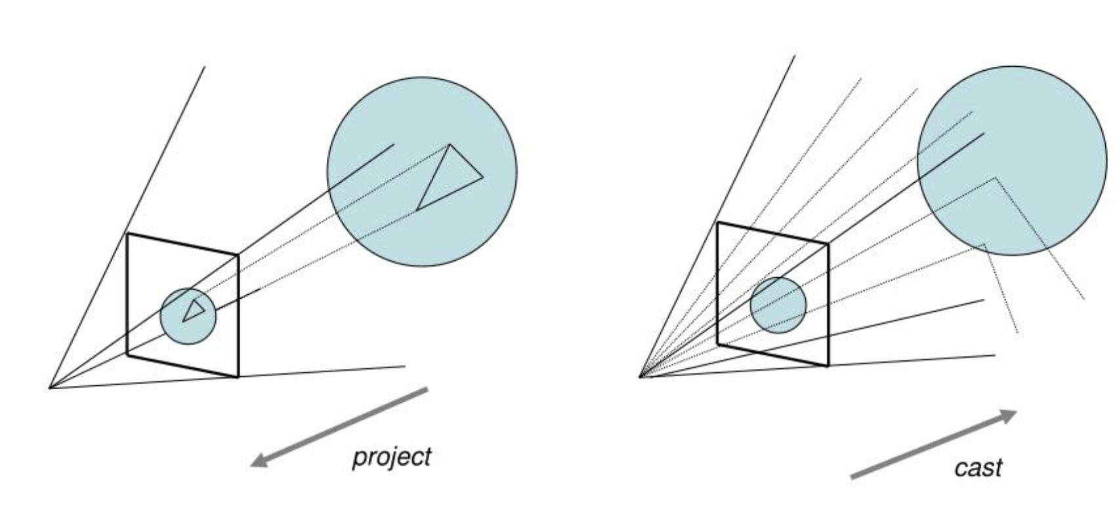
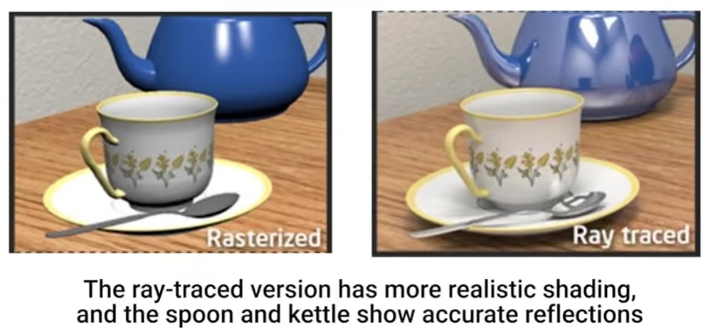
Rendering Techniques
What is Rendering
  Converting a 3D virtual scene into a 2D image.
Paradigm 1: Rasterization (Projecting)
  Projects vertices onto the screen and colors the pixels covered by the triangle.
  Pros: Very fast (real-time, e.g., video games)
  Cons: Inferior rendering quality, struggles to achieve global illumination
Paradigm 2: Ray-tracing (Take a picture)
  Calculating how much energy (photons) is emitted from light sources
  Pros: Photorealistic rendering results
  Cons: Computationally expensive (offline, e.g., movie industry)
The Industry Transition: The Shift to Ray Tracing:
  The Limit of Rasterization Hacks: Developers created complex workarounds to “fake” physical light, which have now hit a wall of complexity and visual artifacts.
  Due to advances in new hardware technologies, the graphics industry is actively transitioning from rasterization-dominated pipelines to ray-tracing techniques
https://www.pixelsham.com/2019/10/24/whats-the-difference-between-ray-tracing-and-rasterization/
https://garagefarm.net/blog/path-tracing-vs-ray-tracing-vs-rasterization-which-graphics-technology-wins

Slide 11
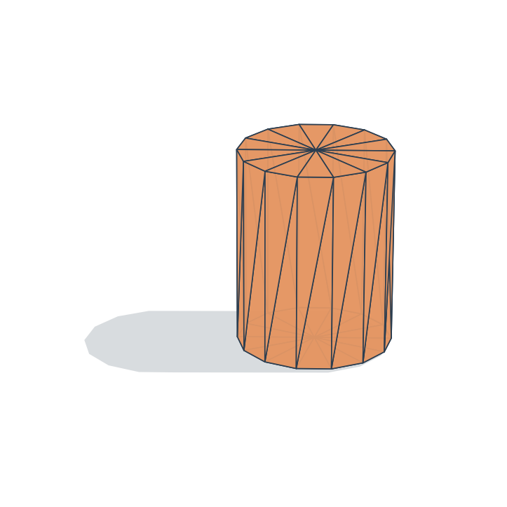

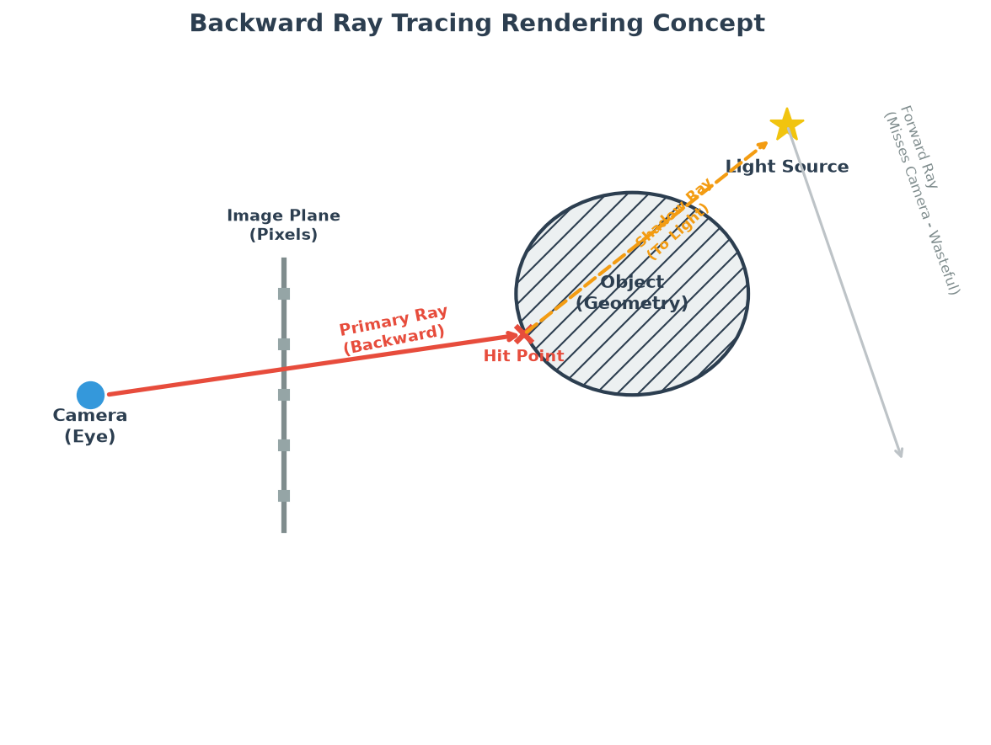
How does Ray Tracing (RT) work?
Simulation of the Physical World
  Light energy (photons) is emitted from light sources, bounces off surfaces, and strikes our eyes or a camera sensor.
  The color we see at any pixel is simply the amount of light energy (wavelength and intensity) that arrives at that specific coordinate.
The Real World (Forward Light):
  A light bulb shines light everywhere. Only a tiny fraction of those rays actually bounce into our eyes or a camera.
The Computational Dilemma
  Simulating all light from the source is too slow because most rays never hit the camera.
"Backward" Ray Tracing (The Solution)
  We work backward. We shoot rays from the camera through each pixel into the 3D scene to see what object is hit and how it is lit.
Casting from light source
(Misses Camera – Wasteful)
Light Source
Shadow Ray
(To Light)
Primary Ray
Camera
(Eye)
Screen
(Pixels)
Scene
Notes:
Welcome to Chapter 1. Before we talk about databases, we must understand the core graphics concept of Ray Tracing. Ray tracing is fundamentally a simulation of the physical world. In the physical world, light sources emit billions of photons. They bounce around, and the ones that hit our eyes form the image. The colors we see are just the intensity and wavelength of light energy. However, simulating this forward is extremely wasteful because most light rays never reach the eye. To save computation, graphics programmers use "backward ray tracing." We shoot rays from the eye through the pixels on the screen, trace them into the scene, and calculate where they hit. This ensures we only compute energy for light that actually hits the camera. Keep this "shooting rays as probes" concept in mind, as it forms the basis of how we will query databases later.

Slide 12
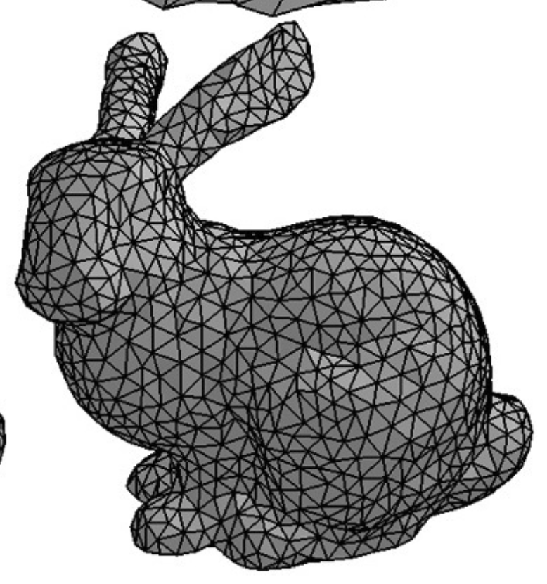
Ray Tracing is a Computationally Heavy Task
Graphics Representation:
  A 3D graphics model is composed of a triangle mesh
  A scene in a modern video game contains tens of millions of triangles
The Core Task:
  Calculate the exact point where a ray intersects a geometric primitive to determine color.
  About 120M rays are needed per second to achieve 1080p@60FPS (1 ray per pixel)
Brute-force Fails:
  To find what a ray hits, we must calculate intersections with the triangles in these meshes.
  Checking a ray against all primitives requires a brute-force O(N) search.
  Ray-triangle intersection tests require heavy floating-point arithmetic.
  Performing O(N) checks for millions of rays is prohibitively slow.
  Optimization Opportunities:
  Parallelism, index, and hardware acceleration
The Stanford “Bunny” Model
Finding which triangle hit by a ray
https://webgl.brown37.net/03_model_data/05_modeling_volume.html
Notes:
Parallelism: Casting rays is parallel
Index: Pruning geometries massively that do not intersect with rays (log(N))
Hardware acceleration: Dedicated ASIC circuits to accelerate ray-tracing

Slide 13
Optimization Opportunities in Ray-tracing
Exploit Parallelism
  Rays cast from each pixel do not have dependency
  Cast rays in parallel (embarrassingly parallel)
Exploit “Spatial Locality”
  Grouping spatially proximal geometries with bounding boxes
  Building a hierarchical data structure for the boxes, which is called an Acceleration Structure (AS) in graphics
Bounding Volume Hierarchy (BVH) tree is the standard AS
  Database designers already know BVHs! A BVH is conceptually very similar to the R-Tree – a spatial index.
  Both partition spatial objects hierarchically using minimum bounding boxes.
  Query logic is the same! From top to bottom and visiting intersecting nodes.
Hardware Acceleration
  BVH traversal is not GPU-friendly, e.g., random memory access, branch divergence
  RT cores – dedicated hardware units on the GPU to accelerate BVH traversal and more

Slide 14
Introduction to BVH
What is a BVH?
  A hierarchical tree structure where leaf nodes contain geometries, and internal nodes represent bounding volumes (Axis-Aligned Bounding Boxes - AABBs).
  Used to prune the search space: if a ray misses a parent bounding box, the entire branch is discarded instantly.
Algorithmically efficient, but not GPU-friendly
  Pointer Chasing: Tree nodes are scattered in memory. Following child pointers results in random memory accesses.
  Thread Divergence: GPU threads run in lockstep (SIMT). If one thread's ray goes deep into the tree while another thread's ray misses immediately, the early-terminating rays are wasting computing resources.
  Stack Management Overhead: Simulating a stack in software causes high register pressure and spilling.
  Instruction Bloat: Most instructions are wasted on traversal bookkeeping (stack push/pop) instead of geometric math.
N_{A}
Logical Pointers
A
C
N_{B}
Nodes
N_{A} | N_{B} | N_{C} | N_{D} | N_{E}
B
E
D
N_{D}
N_{E}
N_{C}
A | B | C | D | E
AABBs
A scene of geometries
BVH of the scene
Memory Layout

Slide 15
Comparison: R-Tree vs. BVH
Feature | R-Tree (Spatial DBs Domain) | BVH (Graphics Domain)
Indexed Geometries | Points, Polygons, Line-strings, Rectangles (Typically in 2D space) | Triangles, curves, user-defined AABBs (Fixed to 3D space)
Query Geometries | Point, Rectangle (range query) | Rays only
Feature | R-Tree (Spatial DBs Domain) | BVH (Graphics Domain)
Indexed Geometries | Points, Polygons, Line-strings, Rectangles (Typically in 2D space) | Triangles, curves, user-defined AABBs (Fixed to 3D space)
Query Geometries | Point, Rectangle (range query) | Rays only
Internal Nodes | Minimum Bounding Rectangles (MBRs) | Axis-Aligned Bounding Boxes (AABBs) (Same concept, different name)
Feature | R-Tree (Spatial DBs Domain) | BVH (Graphics Domain)
Indexed Geometries | Points, Polygons, Line-strings, Rectangles (Typically in 2D space) | Triangles, curves, user-defined AABBs (Fixed to 3D space)
Query Geometries | Point, Rectangle (range query) | Rays only
Internal Nodes | Minimum Bounding Rectangles (MBRs) | Axis-Aligned Bounding Boxes (AABBs) (Same concept, different name)
Build Strategy | Dynamic (insert-by-insert) or bulk | Typically bulk-built
Feature | R-Tree (Spatial DBs Domain) | BVH (Graphics Domain)
Indexed Geometries | Points, Polygons, Line-strings, Rectangles (Typically in 2D space) | Triangles, curves, user-defined AABBs (Fixed to 3D space)
Query Geometries | Point, Rectangle (range query) | Rays only
Internal Nodes | Minimum Bounding Rectangles (MBRs) | Axis-Aligned Bounding Boxes (AABBs) (Same concept, different name)
Build Strategy | Dynamic (insert-by-insert) or bulk | Typically bulk-built
Lifecycle | Long-lived index: Reused across thousands of transactional and analytical queries. | One-shot / Short-lived: Often built, queried once per frame, and immediately discarded.
Feature | R-Tree (Spatial DBs Domain) | BVH (Graphics Domain)
Indexed Geometries | Points, Polygons, Line-strings, Rectangles (Typically in 2D space) | Triangles, curves, user-defined AABBs (Fixed to 3D space)
Query Geometries | Point, Rectangle (range query) | Rays only
Internal Nodes | Minimum Bounding Rectangles (MBRs) | Axis-Aligned Bounding Boxes (AABBs) (Same concept, different name)
Build Strategy | Dynamic (insert-by-insert) or bulk | Typically bulk-built
Lifecycle | Long-lived index: Reused across thousands of transactional and analytical queries. | One-shot / Short-lived: Often built, queried once per frame, and immediately discarded.
Fan-out | High (hundreds child nodes) | Low (2, 4, or 8 child nodes)
Feature | R-Tree (Spatial DBs Domain) | BVH (Graphics Domain)
Indexed Geometries | Points, Polygons, Line-strings, Rectangles (Typically in 2D space) | Triangles, curves, user-defined AABBs (Fixed to 3D space)
Query Geometries | Point, Rectangle (range query) | Rays only
Internal Nodes | Minimum Bounding Rectangles (MBRs) | Axis-Aligned Bounding Boxes (AABBs) (Same concept, different name)
Build Strategy | Dynamic (insert-by-insert) or bulk | Typically bulk-built
Lifecycle | Long-lived index: Reused across thousands of transactional and analytical queries. | One-shot / Short-lived: Often built, queried once per frame, and immediately discarded.
Fan-out | High (hundreds child nodes) | Low (2, 4, or 8 child nodes)
Traversal Engine | Software recursion/stack on the CPU | Dedicated fixed-function hardware (RT Cores)
Feature | R-Tree (Spatial DBs Domain) | BVH (Graphics Domain)
Indexed Geometries | Points, Polygons, Line-strings, Rectangles (Typically in 2D space) | Triangles, curves, user-defined AABBs (Fixed to 3D space)
Query Geometries | Point, Rectangle (range query) | Rays only
Internal Nodes | Minimum Bounding Rectangles (MBRs) | Axis-Aligned Bounding Boxes (AABBs) (Same concept, different name)
Build Strategy | Dynamic (insert-by-insert) or bulk | Typically bulk-built
Lifecycle | Long-lived index: Reused across thousands of transactional and analytical queries. | One-shot / Short-lived: Often built, queried once per frame, and immediately discarded.
Fan-out | High (hundreds child nodes) | Low (2, 4, or 8 child nodes)
Traversal Engine | Software recursion/stack on the CPU | Dedicated fixed-function hardware (RT Cores)
Update Overhead | Low-to-moderate (via node splits/rebalancing) | High (requires refitting coordinates or full rebuild)
Feature | R-Tree (Spatial DBs Domain) | BVH (Graphics Domain)
Indexed Geometries | Points, Polygons, Line-strings, Rectangles (Typically in 2D space) | Triangles, curves, user-defined AABBs (Fixed to 3D space)

Slide 16
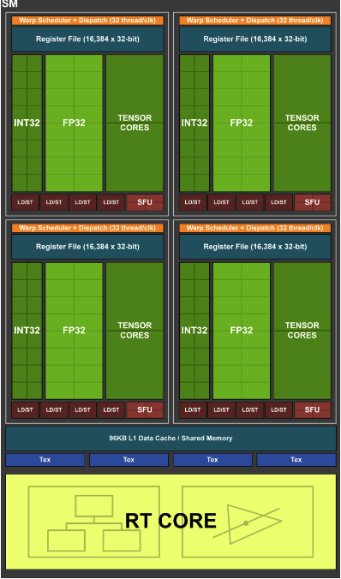
Hardware Accelerated Ray-tracing
BVH traversal is not GPU-friendly
How about designing a new unit to serve this purpose?
NVIDIA introduced RT Cores in the Turing architecture
Two dedicated circuits in RT Cores
  Accelerating BVH Traversal (focused on in this talk)
  Accelerating Ray-triangle intersection test
  Streaming Multiprocessors (SMs) are freed up to do other works
10X Speedups compared to software-emulated BVH traversal
  1.1 Giga Rays on GTX 1080 Ti
  10+ Giga Rays on RTX 2080 Ti
NVIDIA, Turing Architecture Whitepaper

Slide 17
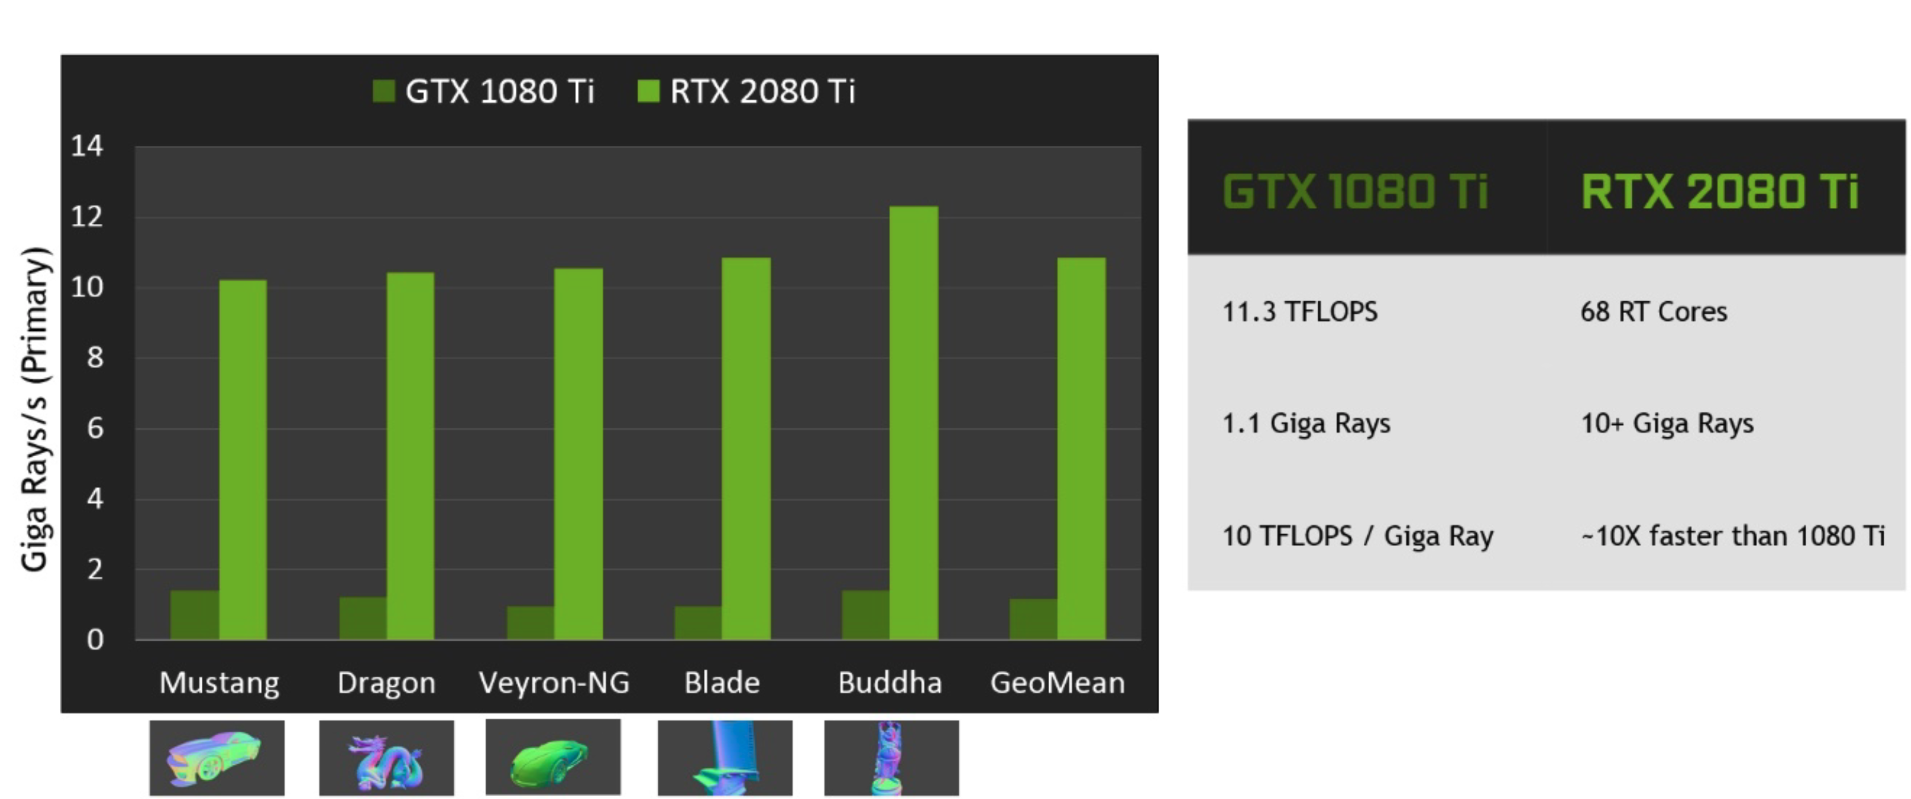
Software vs. Hardware Ray Tracing
Shaders
CUDA Cores
Pre-RT Core Era (Before 2018): Software BVH Traversal
  All traversal and intersection tests were executed as software loops inside compute kernels.
  The GPU's general-purpose compute units (SMs) were heavily bottlenecked by instruction overhead and random memory access (pointer chasing) during tree traversal.
Fetch box
Decode box
Intersection test
Sub-box or tris?
Launch Ray Probe
Many thousands of instruction slots per ray
Ray/triangle
intersection test
Shading
Return hit
RT Core Era (Post-Turing): Hardware Offloading
  Dedicated, fixed-function silicon blocks (RT Cores) placed directly on the GPU alongside general compute units.
  Hardware Offloading: The compute unit executes instructions to 'trace this ray' and suspends or switches to other shading work.
  The RT Core handles the entire BVH tree traversal and ray-triangle intersection tests directly in silicon.
  Frees up the SMs to do computation, delivering up to 10x throughput increases.
RT Cores
Box
Intersection
Evaluators
Launch Ray Probe
Fetch box
Decode box
Intersection test
Sub-box or tris?
Shading
Triangle
Intersection
Evaluators
Ray/triangle
intersection test
Shading
Return hit
NVIDIA, Turing Architecture Whitepaper

Slide 18
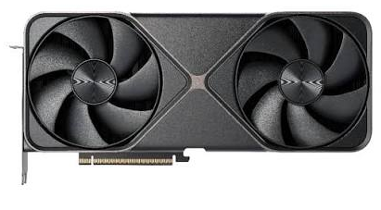
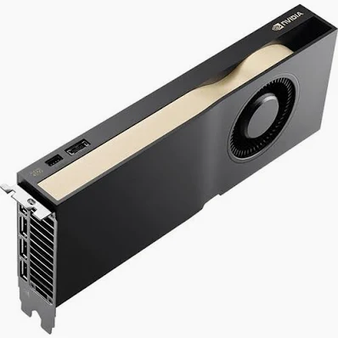
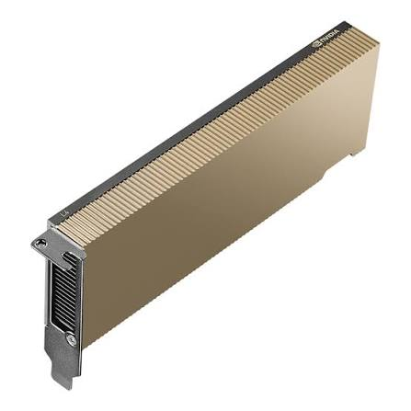




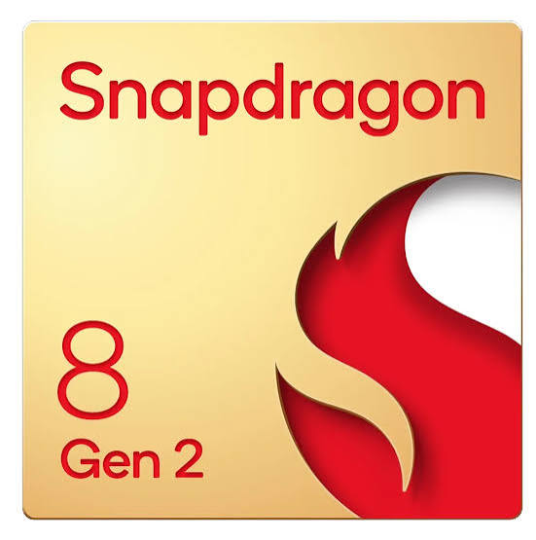
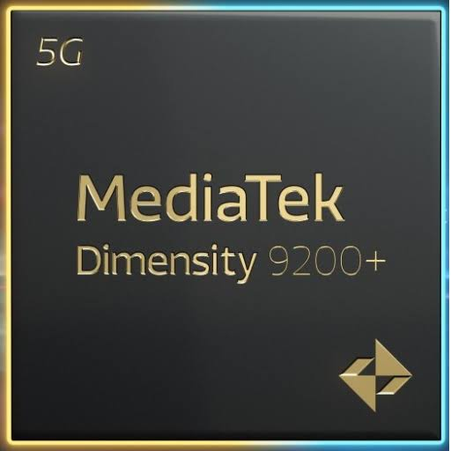
Hardware Landscape: RT Cores are everywhere!
Widely available on Gaming/Workstation/Server grade NVIDIA GPUs
  Gaming: RTX 5090
  Workstation: RTX A6000, NVIDIA RTX Pro 6000
  Server: A10 L4, L40, RTX PRO 4500 Blackwell Server Edition (NO RT Cores on High-End AI GPUs, e.g., NVIDIA A100, and H100)
Broad Industry Support Across Vendors:
  AMD: RDNA 2 (RX 6000 Series) and RDNA 3/4 architectures.
  Intel: Arc A, B, and Max series (Aurora - supercomputer with GPUs equipped with RT cores)
  Apple: M3, M4, and newer Apple Silicon chips.
  Mobile SoCs: Apple A18, Qualcomm Snapdragon 8 Gen 2/3, MediaTek Dimensity 9200/9300 (ARM Immortalis).
This tutorial focuses on NVIDIA RT Cores

Slide 19
Can we do more with RT Cores?
The RT core is essentially a BVH tree accelerator
The connection between rendering and spatial database:
  These domains work is in 2D/3D Euclidean space
  Both need a spatial index to work efficiently
The Idle Silicon: During spatial queries, the specialized RT Core hardware on commodity GPUs sits completely unused.
The "Free Ride" Idea:
  If we can formulate database spatial queries (containment, intersection) as ray casting...
  We can load our R-Tree index data as a BVH, turn queries into rays, and let the RT Core handle the traversal in silicon.
The Benefits:
  Avoid software loops, registers, instruction fetching, and pointer-chasing latency.
  Free, hardware-level acceleration using the GPU you already own.
Idle Silicon

Slide 20
Recent works on RT Cores for non-rendering
kNN Search:
  RTNN, PPoPP’22
  RT-kNNS Unbound, ICS’23
  Arkade, ICS’24
  Stream KNN, CIKM’25
Spatial Queries:
  RayJoin, ICS’24
  LibRTS, PPoPP’25
  RayBooster, VLDB’26
Database Index/Scan:
  RTIndeX, VLDB’23
  RTScan, VLDB’24
  cgRX, ICDE’25
  RayDB, VDLB’26
Graph
  BFS/Triangle Counting, SIGMETRICS’25
  GraphRTX, SIGMOD’26
  Scientific Computing
  RT-DBScan, IPDPS’23
  RT-BarnesHut, PPoPP’25
  RTSpMSpM (Sparse MatMul), ISCA’25
  X-HD (Hausdorff Distance), ICS’26
  Mochi (Collision Detection), ICS’26
  …

Slide 21
Chapter 0: Introduction
Chapter 1: Ray-tracing Meets Spatial Databases
Chapter 2: Ray-tracing Fundamentals
Chapter 3: RT for Spatial Join
Chapter 4: RT for Spatial Indexing
Chapter 5: RT for Spatial Functions (Case Study: Hausdorff Distance)
Chapter 6: RT in Action: Integrating RT into SedonaDB
Conclusion: Summary & Key Takeaways
Content

Slide 22


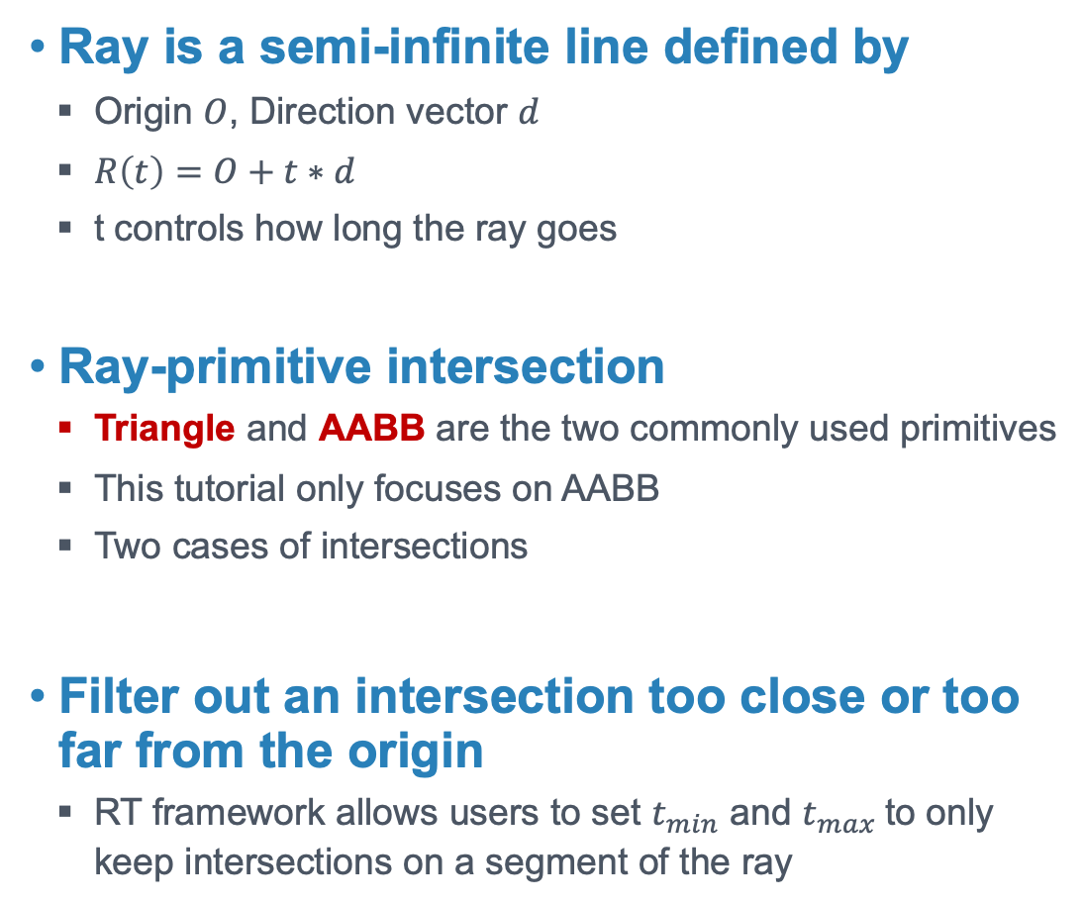



Ray-tracing Basics
Ray is a semi-infinite line defined by
  Origin $O$, Direction vector $d$
  $R\left(t\right)=O+t∗d$
  t controls how long the ray goes
Ray-primitive intersection
  Triangle and AABB are the two commonly used primitives
  This tutorial only focuses on AABB
  Two cases of intersections
Filter out an intersection too close or too far from the origin
  RT framework allows users to set $t_{min}$ and $t_{max}$ to only keep intersections on a segment of the ray
$$O$$
$$d$$
$t_{max}$
$t_{min}$
$t_{hit}$
Case 1: Hit the boundary of an AABB
Case 2: Ray origin is within an AABB

Slide 23
Execution Workflow
To use NVIDIA RT Cores, we adopt NVIDIA OptiX
  An RT programming framework (alternatives are available, e.g., Vulkan)
  CUDA with restrictions (e.g., shared memory, synchronization).
  Programmers write shaders (callbacks) to cast rays and handle intersections
Two stages
  Stage1: Provide primitives to build the BVH (happens on CUDA cores)
  Stage2: Cast rays and process intersections with the shaders
Traversal done
Build BVH
RayGen
Shader
BVH Traversal
Found
A Hit?
Yes
ClosestHit
Shader
Leaf Node
No
No
Primitives
IsIntersection
Shader
Report
Hit?
Yes
AnyHit
Shader
Miss
Shader

Slide 24
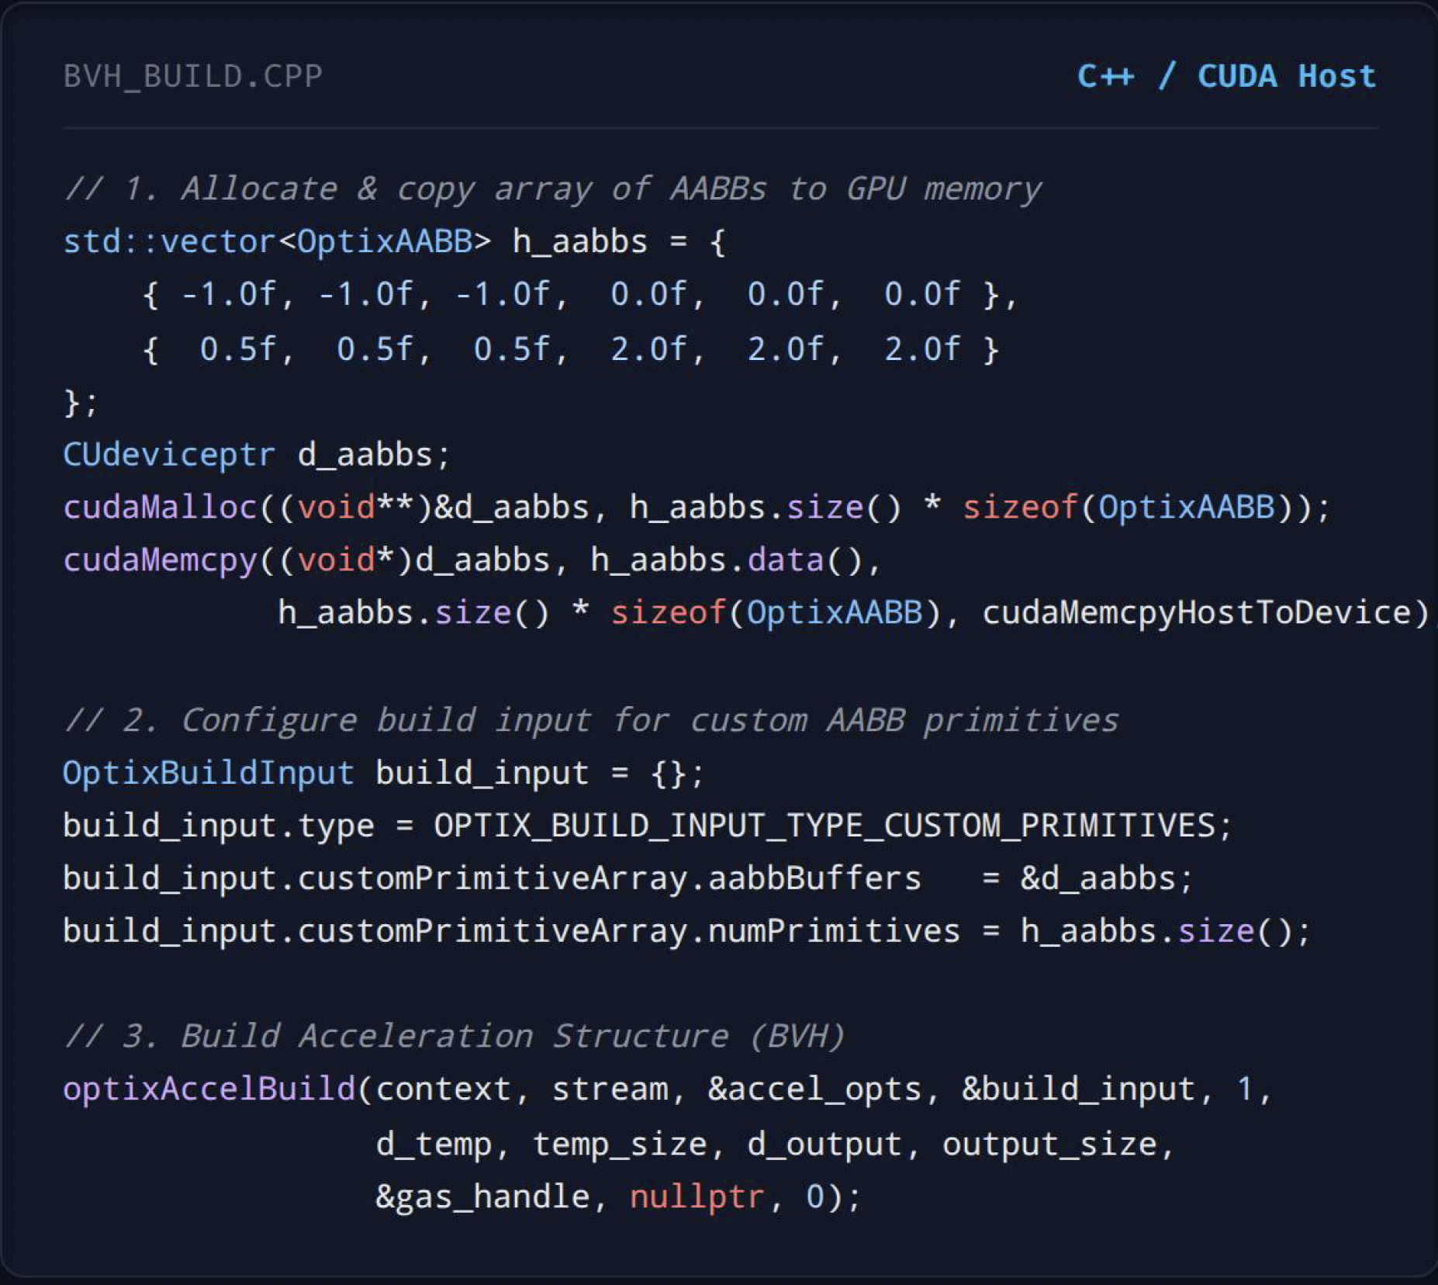
Host: BVH Building with AABB Array
Custom Primitives Pipeline
  Device Memory Copy: Copy an array of OptixAABB structures representing bounding boxes to GPU VRAM.
  Custom Primitive Input: Set OPTIX_BUILD_INPUT_TYPE_CUSTOM_PRIMITIVES to instruct OptiX to build a BVH over user AABBs.
  Acceleration Build: optixAccelBuild constructs the BVH handle used in ray tracing.

Slide 25
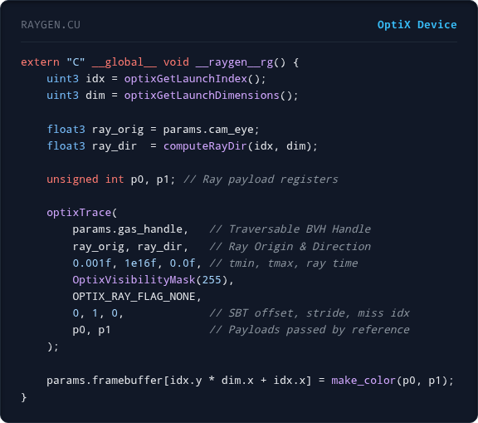
Device: Ray Generation Shader
RayGen Shader
  Pipeline Entry Point: Invoked per launch index (pixel/work item) to do the work by a thread.
  Ray Traversal Initiation: Calls optixTrace to send rays to traverse the BVH tree.
  Payload Management: Passes payload variables (p0, p1) by reference to communicate with other shaders.

Slide 26
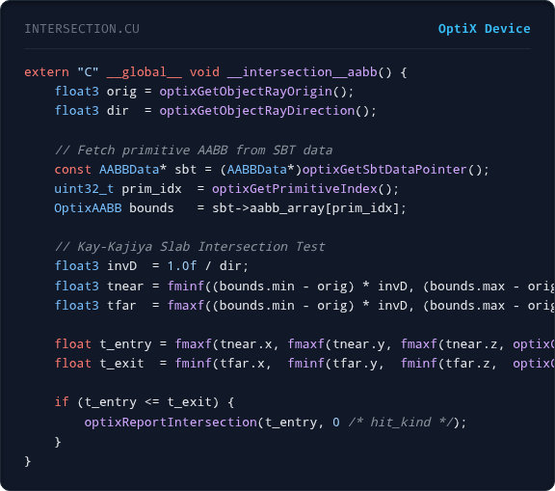
Device: Custom Intersection Shader
Intersection Shader
  Invoked when traversing to a leaf node of the BVH
  The ray potentially hit the AABB. You have to verify the intersection in the shader.
  Primitive Lookup: Uses optixGetPrimitiveIndex() to retrieve the index of the AABB being hit.
  Slab Intersection: Computes ray entry (t_entry) and exit (t_exit) distances across all 3 axes.
  Report Hit: Triggers optixReportIntersection() if the ray enters the box before exiting.

Slide 27
Challenge 1: The Architectural Mismatch
Form of Spatial Database Query (What we want)
  Queries are expressed as diverse multidimensional spatial shapes (Points, Lines, Polygons).
Fixed-Function RT Core Hardware (What we have)
  STRICT INPUT: The hardware instruction only accepts rays.
  It only returns intersection events (hits/misses) along that ray.
The Core Engineering Mismatch:
  How do we execute 2D/3D database queries using an accelerator that only understands rays?
Point
LineString
Polygon
AABB
Ray

Slide 28
Challenge 2: Hardware Precision Limitations
Graphics Precision vs. Database Correctness
  RT Cores natively run single-precision (FP32) float math for performance reasons and save silicon space.
  In graphics, visual plausibility is sufficient. If a ray misses a triangle boundary, a pixel color is slightly off, which is almost invisible to the human eye.
  Spatial databases store coordinates in double-precision (FP64) to represent physical GIS data accurately.
The Risk of FP32 Rounding Errors:
  Rounding coordinates from FP64 to FP32 before passing them to RT cores introduces numerical drift.
  A ray might pass right through the edge of a bounding box without reporting a hit in FP32 hardware.
  This causes false negatives (silently missing query results), which violates correctness.
  We must design a solution to guarantee FP64 correctness.

Slide 29



Challenge 3: Thread Load Balancing on GPUs
Single-ray Execution Model
  In OptiX, intersections will be handled by the thread that casts the ray.
  Intersections will be sequentially processed.
  Shaders run on the single thread!
Spatial Data Skewness
  Real-world geospatial data is highly skewed, e.g., millions of GPS points in downtown Manhattan, while very few are in the surrounding water.
  Ray Tracing Skew: Rays pointing to a dense area may traverse more nodes and go deep into BVH trees, testing thousands of overlapping geometries.
  Standard GPU load-balancing cannot be used inside RT shaders due to hardware restrictions (sync., shared mem. are banned)
$$y$$
1.0
Thread 1
Thread 2
Thread 3
$$o$$
1.0
$$x$$

Slide 30
Chapter 0: Introduction
Chapter 1: Ray-tracing Meets Spatial Databases
Chapter 2: Ray-tracing Fundamentals
Chapter 3: RT for Spatial Join
Chapter 4: RT for Spatial Indexing
Chapter 5: RT for Spatial Functions (Case Study: Hausdorff Distance)
Chapter 6: RT in Action: Integrating RT into SedonaDB
Conclusion: Summary & Key Takeaways
Content

Slide 31

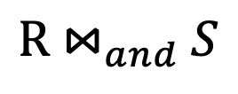

Starting from Polygon Clipping
Polygon clipping constructs the geometric region from two shapes that satisfies a given spatial predicate (such as AND, OR).
Can be decomposed into two sub-operations
  Finding Line Segment Intersection (LSI)
  Point-in-polygon (PIP) test
If we can turn these two operations into ray-casting operations, we can take a free ride over this powerful hardware!
Introducing “RayJoin: Fast and Precise Spatial Join”
  Line-segment Intersection
${\text{R ⋈}}_{and} S$
$$S$$
  Point-in-polygon Test
$$\text{R}$$

Slide 32
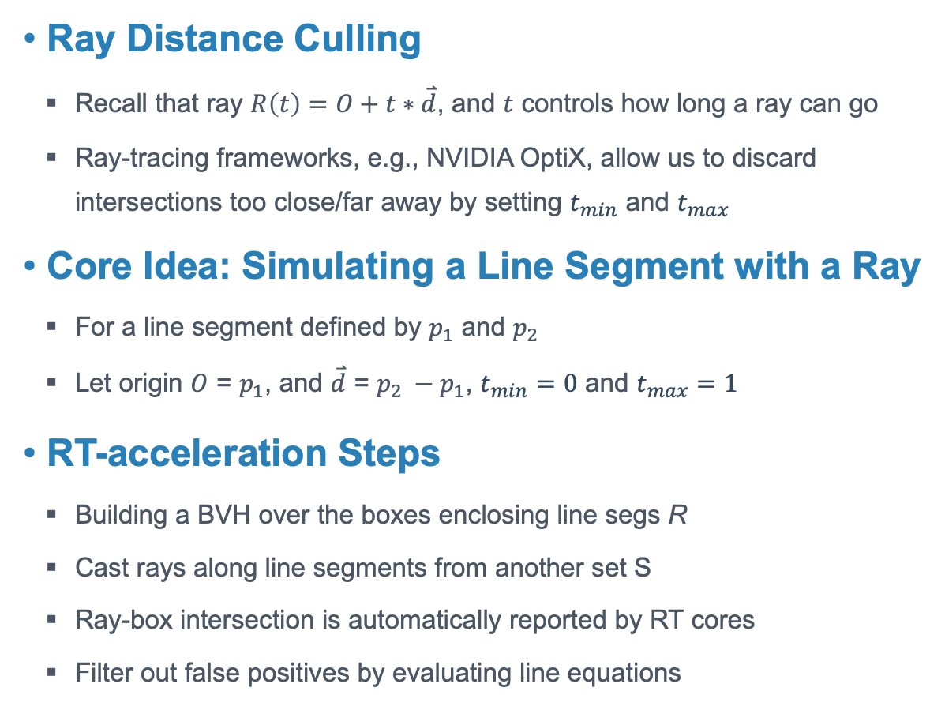








Line Segment Intersection by Ray-tracing
Ray Distance Culling
  Recall that ray $R\left(t\right)=O+t∗\overset{⃑}{d}$, and $t$ controls how long a ray can go
  Ray-tracing frameworks, e.g., NVIDIA OptiX, allow us to discard intersections too close/far away by setting $t_{min}$ and $t_{max}$
  Core Idea: Simulating a Line Segment with a Ray
  For a line segment defined by $p_{1}$ and $p_{2}$
  Let origin $O$ = $p_{1}$, and $\overset{⃑}{d}$ = $p_{2} −p_{1}$, $t_{min}=0$ and $t_{max}=1$
RT-acceleration Steps
  Building a BVH over the boxes enclosing line segs R
  Cast rays along line segments from another set S
  Ray-box intersection is automatically reported by RT cores
  Filter out false positives by evaluating line equations
$$\overset{⃑}{d}$$
$$t_{min}$$
$$t_{hit}$$
$$t_{max}$$
AABB₂
O
AABB₁
$$t_{max}$$
$p_{1}$
$p_{2}$
$$t_{min}$$
False Positive
Simulate Line Seg. with a Ray
S
R
BVH over the boxes

Slide 33
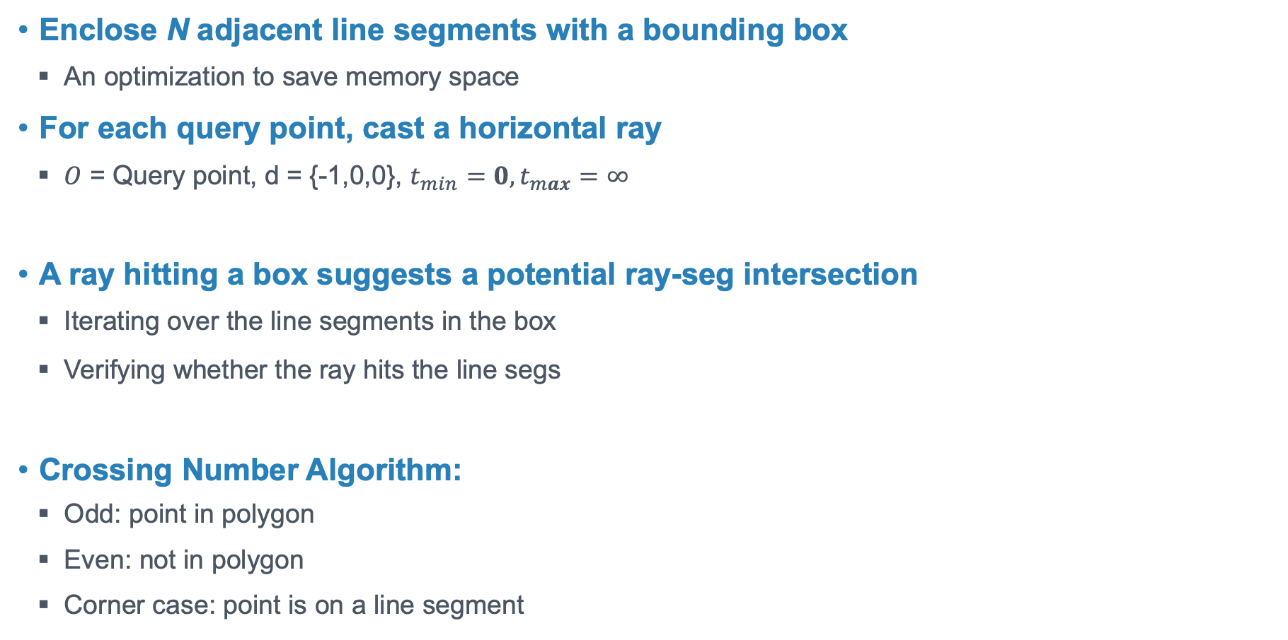
Point-in-polygon by Ray-tracing
Enclose N adjacent line segments with a bounding box
  An optimization to save memory space
For each query point, cast a horizontal ray
  $O$ = Query point, d = {-1,0,0}, $t_{min}=0,t_{max}=∞$
A ray hitting a box suggests a potential ray-seg intersection
  Iterating over the line segments in the box
  Verifying whether the ray hits the line segs
Crossing Number Algorithm:
  Odd: point in polygon
  Even: not in polygon
  Corner case: point is on a line segment
Q₁
Q₂

Slide 34
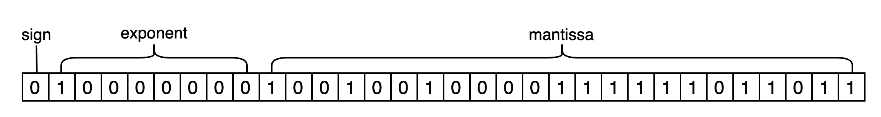

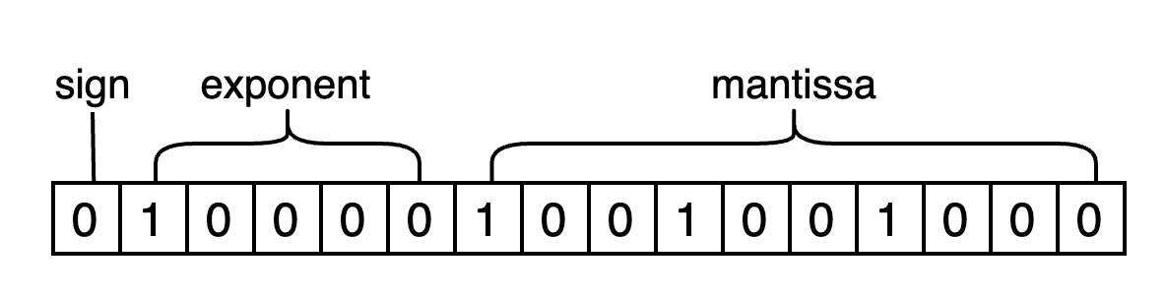
Limited Precision
Geospatial data typically requires double precision
RT Cores only support single precision for performance reasons
Mantissa bits are truncated
IEEE 754 - ”roundTiesToEvent” rules
Rounding up/down depends on the left-over bits
FP32
FP16
Here we show the conversion from FP32 to FP16 for convenience.

Slide 35
Consequences: Geometric inconsistencies
False-positive is acceptable
False-negative leads to missing intersections
Intersections are missing for LSI, and the results are wrong for PIP!
High Precision
False positive
False Negative

Slide 36
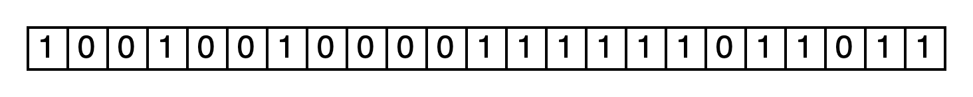
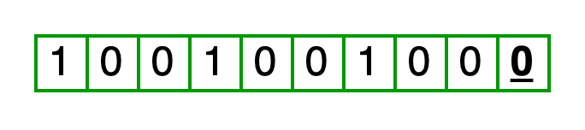




Solution to Overcome Limited Precision
Create an oversized bounding box?
  Not big enough → False negatives
  Too big → Too many false positives, hurting performance
Conservative Representation
  Add 1 to mantissa bits to the downcast number
  Guarantee to enclose line seg in high-precision
Downcast
y
Mantissa Bits
$$x_{r}$$
$$x_{r}^{d}$$
O
x
$$x_{r}^{d}$$
$$x_{r}$$

Slide 37
Reduce BVH Construction Cost
An AABB bounds only one line segment
Put spatially close line segments together
Time and space costs
Building time is 9.4x ~ 11.8x longer than queries
BVH takes 2.4 GB of device memory for 69M line segments

Slide 38
Experimental Setup
NVIDIA OptiX 8.0, CUDA 12
For GPU baselines: NVIDIA RTX 3090
For CPU baselines: AWS r5.4xlarge,16 Cores, 128 GB Memory
Artifact | Platform | Description
Uniform Grid | GPU | grid-based spatial index
LBVH | GPU | software emulated BVH
cuSpatial | GPU | spatial library from NVIDIA, quad-tree
PSSL | GPU | plane-sweep in CUDA
RasterJoin | GPU | rasterization-based PIP in OpenGL
GLIN | CPU | Learned index
EPUG-Overlay | CPU | two-level uniform grid
Kinetica | CPU | in-memory spatial database
PostGIS | CPU | disk-based spatial database
RasterIntervals | CPU | rasterization-based

Slide 39
Real-world Datasets Worldwide
Dataset | Line Segs | Polygons | Description
County | 1.0M | 3.1K | Boundaries of the U.S. Counties
Zipcode | 23.9M | 32.2K | ZIP Code areas for the USPS
Block | 29.3M | 239.2K | Census block groups in the U.S.
Water | 25.6M | 463.6K | Major water features in the U.S.
Dataset | Line Segs | Polygons | Description
LKAF | 1.8M | 18.2K | Water areas in Africa
PKAF | 1.3M | 25.7K | Parks or green areas in Africa
LKAS | 10.3M | 151.6K | Water areas in Asia
PKAS | 11.9M | 172.6K | Parks or green areas in Asia
LKAU | 1.2M | 14.5K | Water areas in Australia
PKAU | 567.1K | 12.8K | Parks or green areas in Australia
LKEU | 27.9M | 654.8K | Water areas in Europe
PKEU | 65.9M | 1.9M | Parks or green areas in Europe
LKNA | 69.3M | 1.6M | Water areas in North America
PKNA | 26.9M | 303.0K | Parks or green areas North America
LKSA | 2.4M | 32.6K | Water areas in South America
PKSA | 3.2M | 49.5K | Parks or green areas in South America

Slide 40
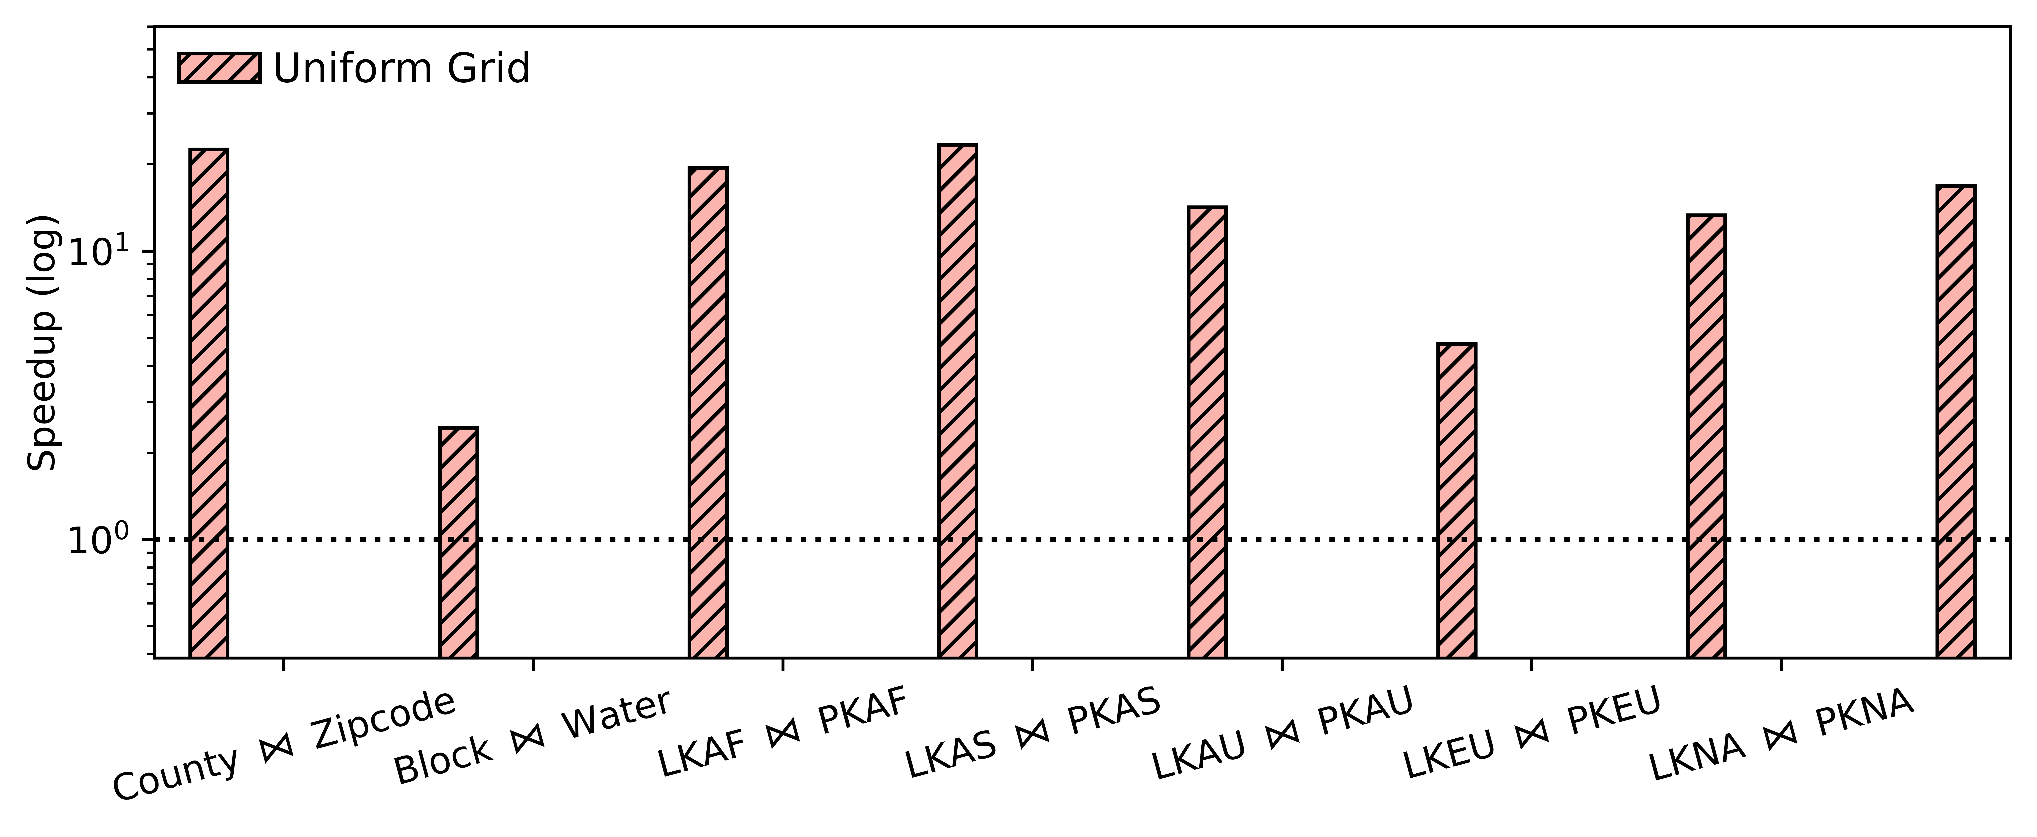
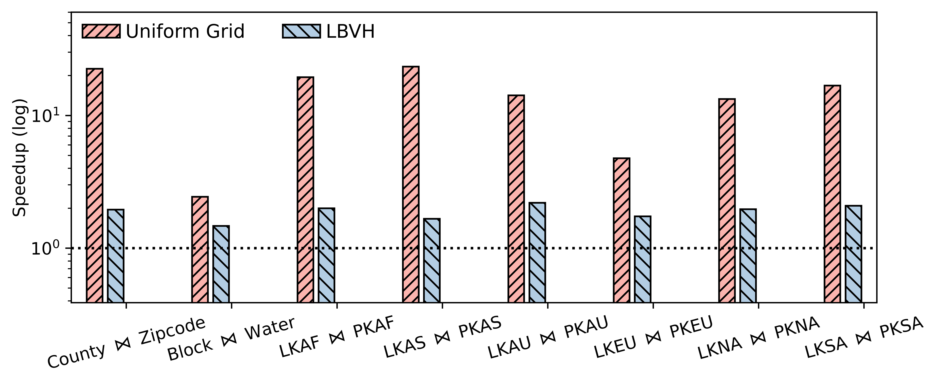
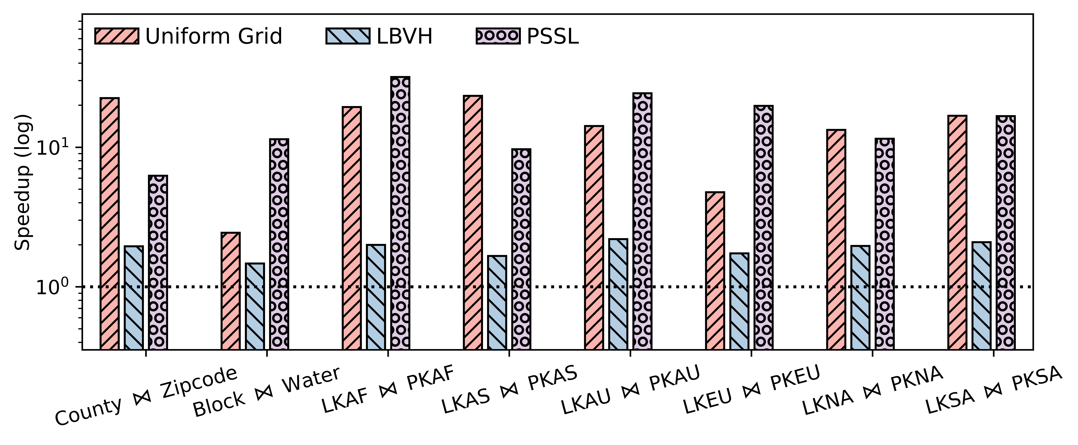
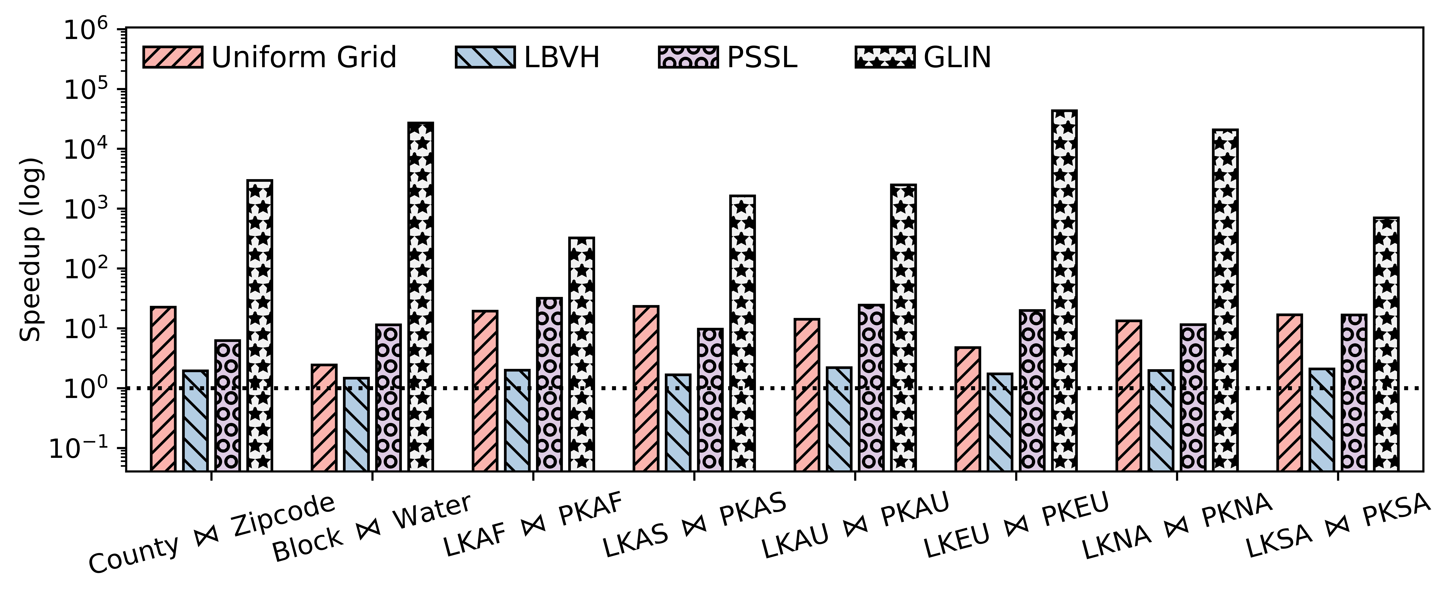

LSI Performance
Speedups over the baseline
  End to end: H2D, BVH Construction, and Query
  Speedups: 1.5x $\sim$ 2.4x over the best baseline
  Longest execution time: 208ms
The best baseline 409 ms
GPU-based

Slide 41
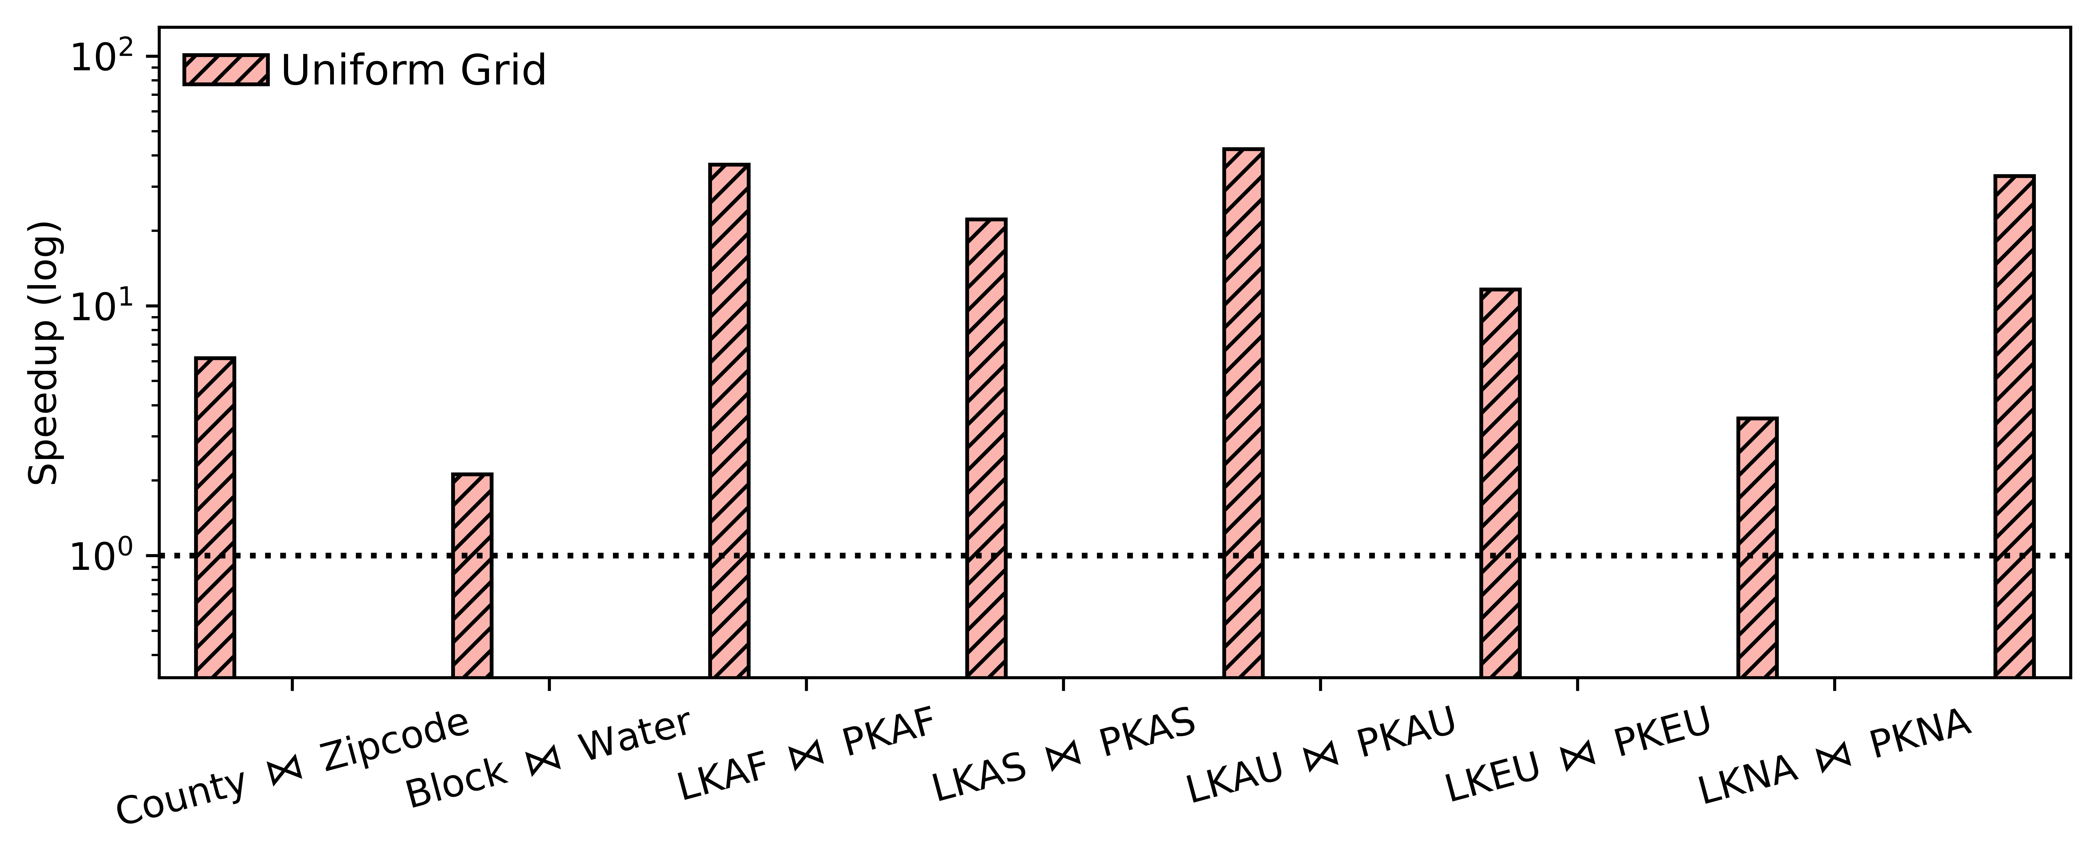
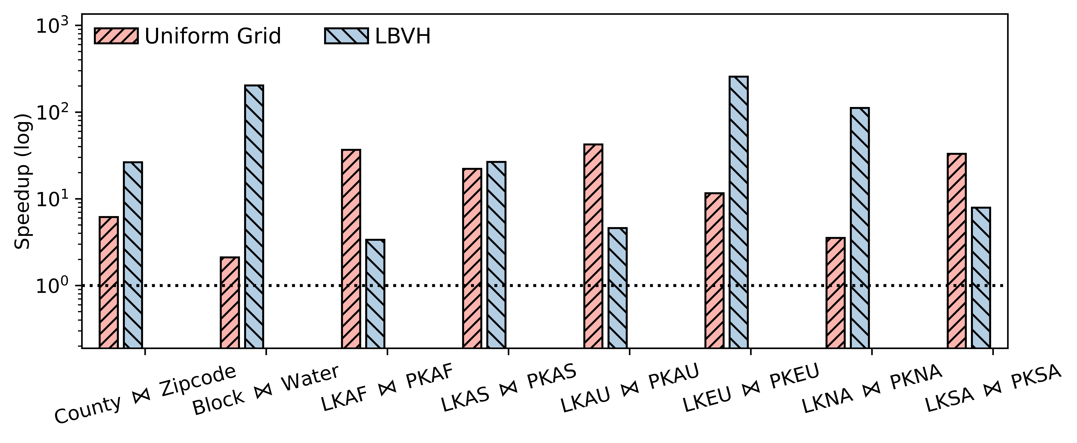
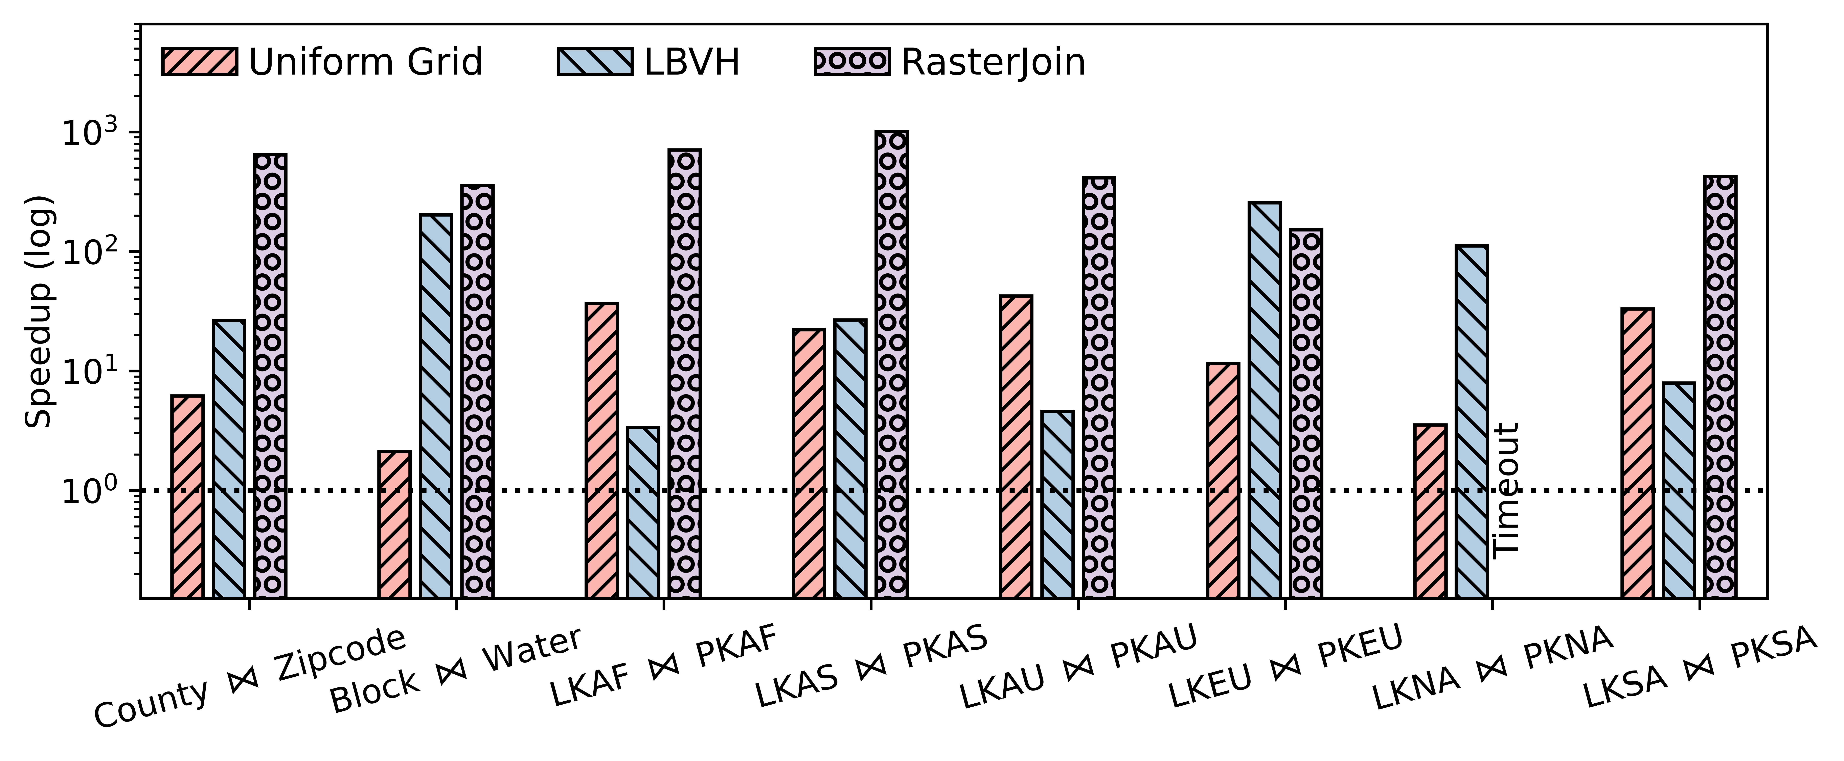
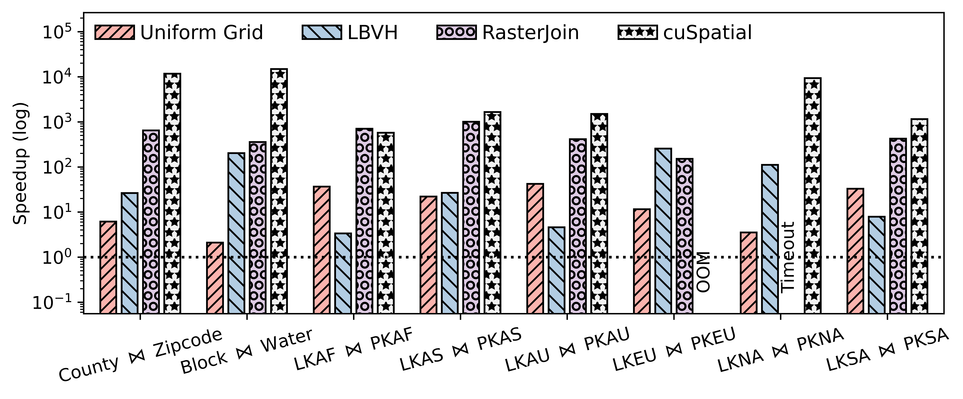

PIP Performance
Speedups over the best baseline
  All baselines are GPU-based
  End-to-end: 2.1x $\sim$ 22.2x
  Longest execution time: 253 ms
The best baseline 2942 ms
Not real time

Slide 42
Takeaways on Spatial Join by RT Cores
RT Core has huge potential for spatial joins because ray-tracing and spatial workloads share many similarities.
Must formulate the problem as an RT problem to exploit the hardware.
Precision limitation can be overcome by using the conservative bounding box.
With RT cores, we can join millions of polygon less than one second

Slide 43
Chapter 0: Introduction
Chapter 1: Ray-tracing Meets Spatial Databases
Chapter 2: Ray-tracing Fundamentals
Chapter 3: RT for Spatial Join
Chapter 4: RT for Spatial Indexing
Chapter 5: RT for Spatial Functions (Case Study: Hausdorff Distance)
Chapter 6: RT in Action: Integrating RT into SedonaDB
Conclusion: Summary & Key Takeaways
Content

Slide 44
A Comparison between RT cores and A Spatial Index
What are available?
  A Ray Tracing Accelerator
  Ray-Primitive Intersection
  High-performance (10 GRays/s)
  Only supports coordinate updates.
  Customized programming interface (OptiX, Vulkan…)
What we want to deliver
  A Spatial Index Library
  Support Point & Range Queries
  Need quick response
  Mutable, e.g., insert, delete geoms.
  An easy interface for programming
We develop LibRTS for the following two purposes
To repurpose RT core as a general spatial index
A library for non-RT programmers to use

Slide 45
Query Scope
Point Query
  Given a set of MBRs and points
  Return all MBR-point pairs satisfying the containment test
MBR Containment Query
  Given two sets of MBRs
  Return all MBR-MBR pairs satisfying the containment test
MBR Intersection Query
  Given two sets of MBRs
  Return all MBR-MBR pairs satisfying the intersection test
Point-MBR Containment Test
MBR-MBR Containment Test
MBR-MBR Intersection Test

Slide 46















MBR-Point and MBR-MBR Containment Query
Use a short ray to simulate a point
  Setting $t_{min}=0, t_{max}=FLT_MIN$
  For each hit, evaluate the containment test
Reduce MBR-MBR to Point-MBR query
  If an MBR contains another one, its center point must also be contained
Hit
$$r_{1}$$
$$r_{1}$$
Hit, False Positive
$$s_{1}$$
$$s_{1}$$
$$s_{2}$$
$$s_{2}$$
Miss
Build BVH
$$r_{2}$$
$$r_{2}$$
Cast Rays
max
$$s_{3}$$
$$r_{3}$$
$$s_{3}$$
$$r_{3}$$
$$s_{4}$$
$$s_{4}$$
min
Case 2: Ray origin is
within an AABB
Reduce

Slide 47






MBR-MBR Intersection Query
Observation: two MBRs intersect $↔$ One of the cases is true
  Case 1: Diagonal of $s$intersects $r$
  Case 2: Anti-diagonal of $r$ intersects $s$
  Case 3: (Anti-)diagonal and rectangle are mutually intersecting
$$s$$
$$r$$
$$r$$
$$s$$
$$r$$
$$s$$
Case 1
Case 2
Case 3

Slide 48







MBR-MBR Intersection Query by Ray-casing
  Any (anti)-diagonal-rectangle intersection suggests an MBR-MBR intersection
  The diagonal can be simulated with a ray!
  Cast rays from the diagonals of $R$ and $S$ to find all the intersections
  Merge the intersections found by the three cases
$$p_{2}$$
$$t_{max}=1$$
$$O=p_{1}$$
$$d=p_{2}−p_{1}$$
$$p_{1}$$
$$t_{min}=0$$

Slide 49
Load Balancing Challenge
  Single Ray Programming Model
  Each thread casts a single ray
  The shaders triggered by the ray will also be executed by the ray-casting thread, serially!
  This model is designed to simplify programming, but it also results in load imbalance
$$y$$
1.0
Thread 1
3 Intersections
Thread 2
2 Intersections
Thread 3
1 Intersections
$$o$$
1.0
$$x$$

Slide 50




Our Load Balancing Solution
  Why the existing GPU load balancing does not work
  The number of intersections is unknown until the ray is cast.
  Thread block/warp synchronization primitives are unavailable.
  Our technique: Ray-Multicast
  Divide the scene into non-overlapping sub-spaces
  Put the rectangles into subspaces in a round-robin manner
  Cast the ray into the sub-spaces
$$y$$
1.0
$$o$$
$$x$$
$$y$$
1.0
1.0
$$o$$
1.0
2.0
3.0
$$x$$

Slide 51
Mutability Challenge
  How can we adapt to dynamic data processing?
  Insert/Delete/Update geometries
  RT cores only support updating the coordinates of geometries
  Rebuilding the BVH is not an option (too expensive)

Slide 52
Our Solution to Mutability
  Insertion by Two-Level Acceleration Structures
  Accumulate a batch of insertions
  Build a separate BVH (BLAS) for the insertions
  Then, just rebuild the TLAS (very fast) to include the newly built BVH
  Deletion by Degeneration
  Turn the deleted geometries into a degenerated form, e.g., zero-extent
  Then, we use the refit function provided by OptiX
TLAS
TLAS
Instance
Instance
Instance
Instance
Instance
Instance
[ ]
[ ]
[ ]
[ ]
[ ]
[ ]
Identitfy
Transformation Matrix
Incoming Insertions
BLAS
BLAS
BLAS
Build
[ ]
[ ]

Slide 53
Evaluated Artifacts
  Spatial libraries in production and research prototypes
Artifact | Index Type | Query Type | Platform*
Boost | R-Tree | Point, Range | CPU
CGAL | KD-Tree | Point | CPU
ParGeo | KD-Tree | Point | CPU
GLIN | Learned Index | Range | CPU
LBVH | Linear BVH | Point, Range | GPU
cuSpatial | Octree | Point | GPU
RayJoin | BVH on RT cores | Point in Polygon (PIP) | GPU
LibRTS | BVH on RT cores | Point, Range, PIP | GPU
*All CPU-based artifacts are parallelized

Slide 54
Evaluation Settings
  Environments
  GPU: NVIDIA RTX 3090
  CPU: AMD EPYC 7713 (128 cores)
  CUDA 12.3
  OptiX 8.0
  Datasets
Dataset | # of Polygons | Description
USCounty | 12.2 K | Boundaries of the U.S. Counties
USCensus | 248.9 K | U.S. Census Block Groups
USWater | 463.6 K | Boundaries of U.S. Water Resources
EUPark | 1.9 M | Parks and Green Areas in Europe (sampled from OSM)
OSMLakes | 8.3 M | Boundaries of Water Areas Worldwide
OSMParks | 11.5 M | Parks and Green Areas Worldwide

Slide 55
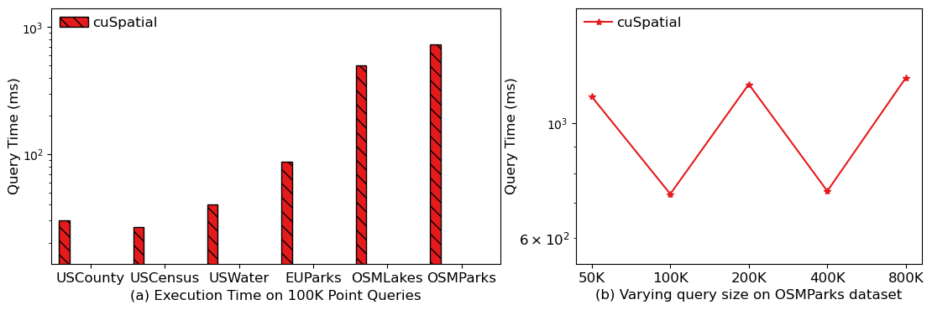
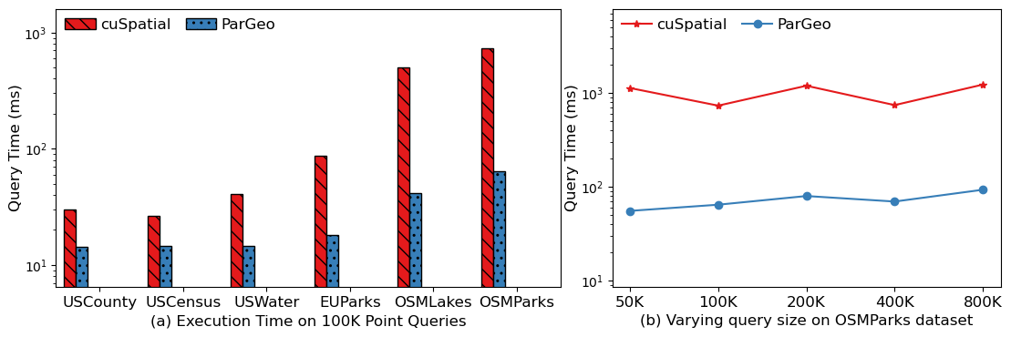
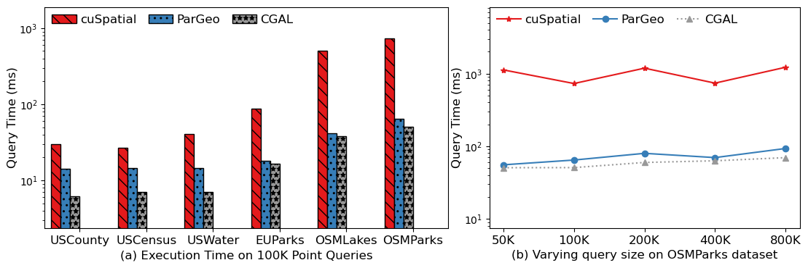
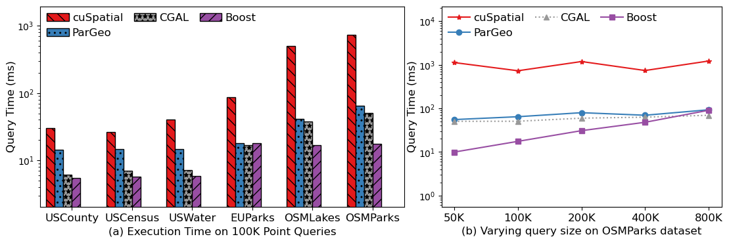
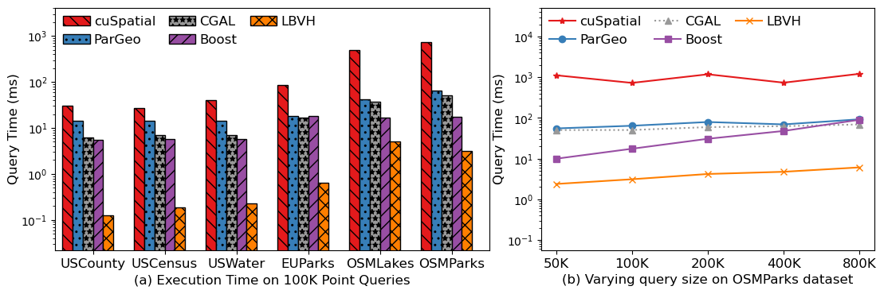
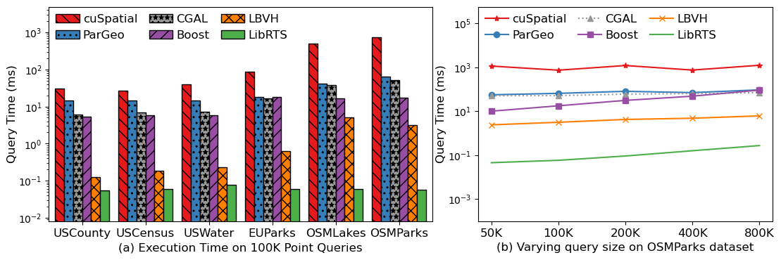
Point Query
  Setting 1: Fix # of point queries to 100K
  Each query at least falls within a rectangle
  Setting 2: Varying query sizes on OSMParks
up to
85.1x

Slide 56
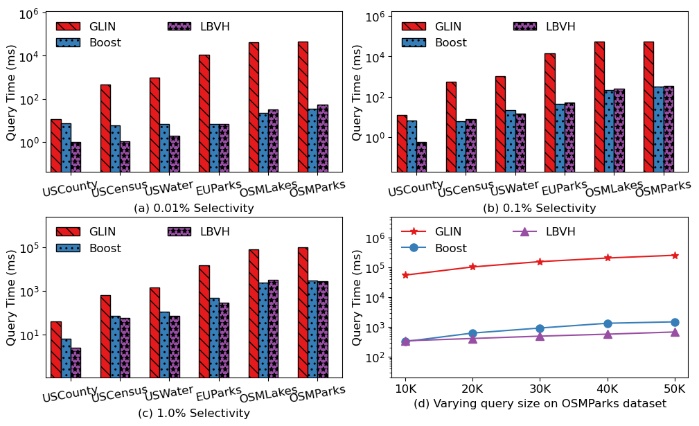
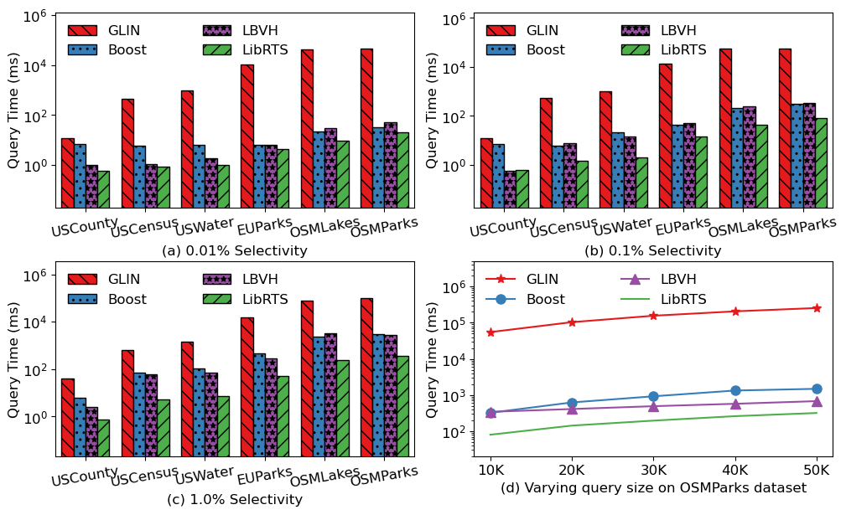
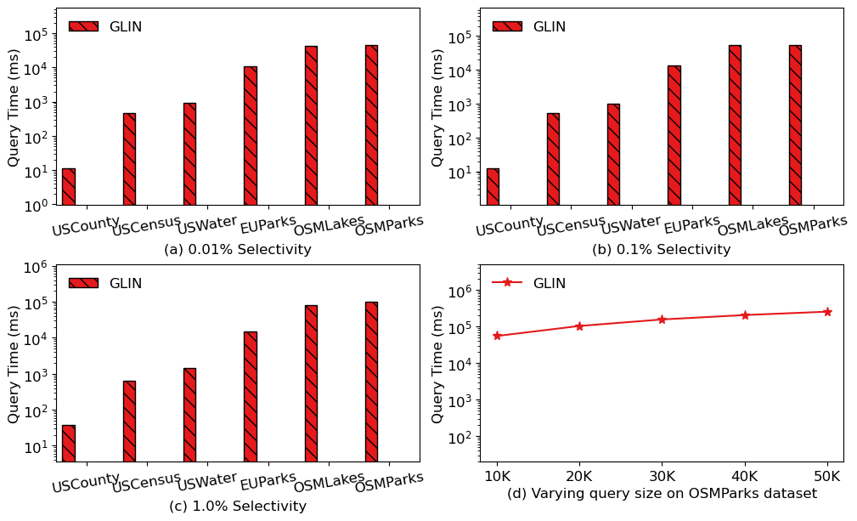
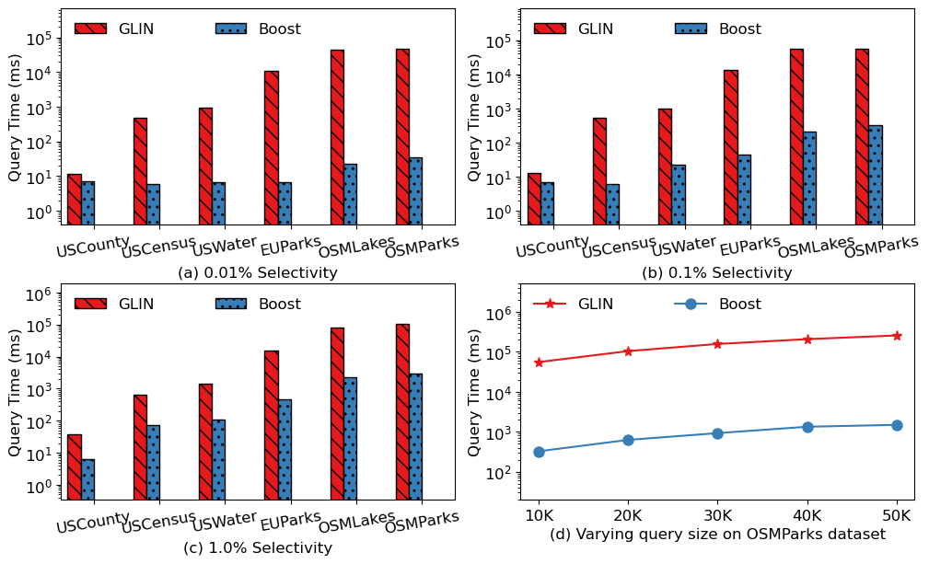
Range Query - Intersects
  Setting 1: Fix # of range queries to 10K
  Varying selectivity by 0.01%, 0.1%, and 1%
  Setting 2: Varying query sizes on OSMPark
up to 2.3x
up to 6.8x
up to 11.0x

Slide 57
Takeaways on RT-accelerated Spatial Index
  We have successfully repurposed RT Cores to develop LibRTS, a general spatial index library
  Achieving top-tier performance as the fastest Spatial Indexing tool
  Three major technical challenges have been addressed: translation, load-balancing, and mutability
  Our solutions can be used for RT software development in other applications
  LibRTS is developed for non-RT programming users too, aiming for broad adoption in the applications community
  It is a header-only library with an easy interface

Slide 58
Chapter 0: Introduction
Chapter 1: Ray-tracing Meets Spatial Databases
Chapter 2: Ray-tracing Fundamentals
Chapter 3: RT for Spatial Join
Chapter 4: RT for Spatial Indexing
Chapter 5: RT for Spatial Functions (Case Study: Hausdorff Distance)
Chapter 6: RT in Action: Integrating RT into SedonaDB
Conclusion: Summary & Key Takeaways
Content

Slide 59




What is the Hausdorff Distance (HD)?
The Hausdorff Distance is a spatial metric used to measure the dissimilarity between two sets of points.
?
It quantifies the maximum distance from a point in one set to its nearest point in the other set.
$$\overset{⃑}{H}\left(A, B\right)$$
(Directed) Hausdorff Distance:
Point Set A
$$\overset{⃑}{H}\left(A, B\right)=\max_{a∈A}\{\min_{b∈B}\{|\left|a,b\right||\}\}$$
Point Set B
Felix Hausdorff (1868-1942), German mathematician
Notes:
Remember that we want to find the maximum of nearest distances between the two sets, so this red circle is the most possible place that gives us the anser
We draw a circle from the black point, and the dashed line is the maximum value of the nearest distance

Slide 60






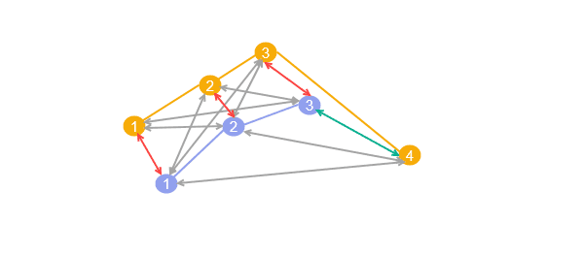
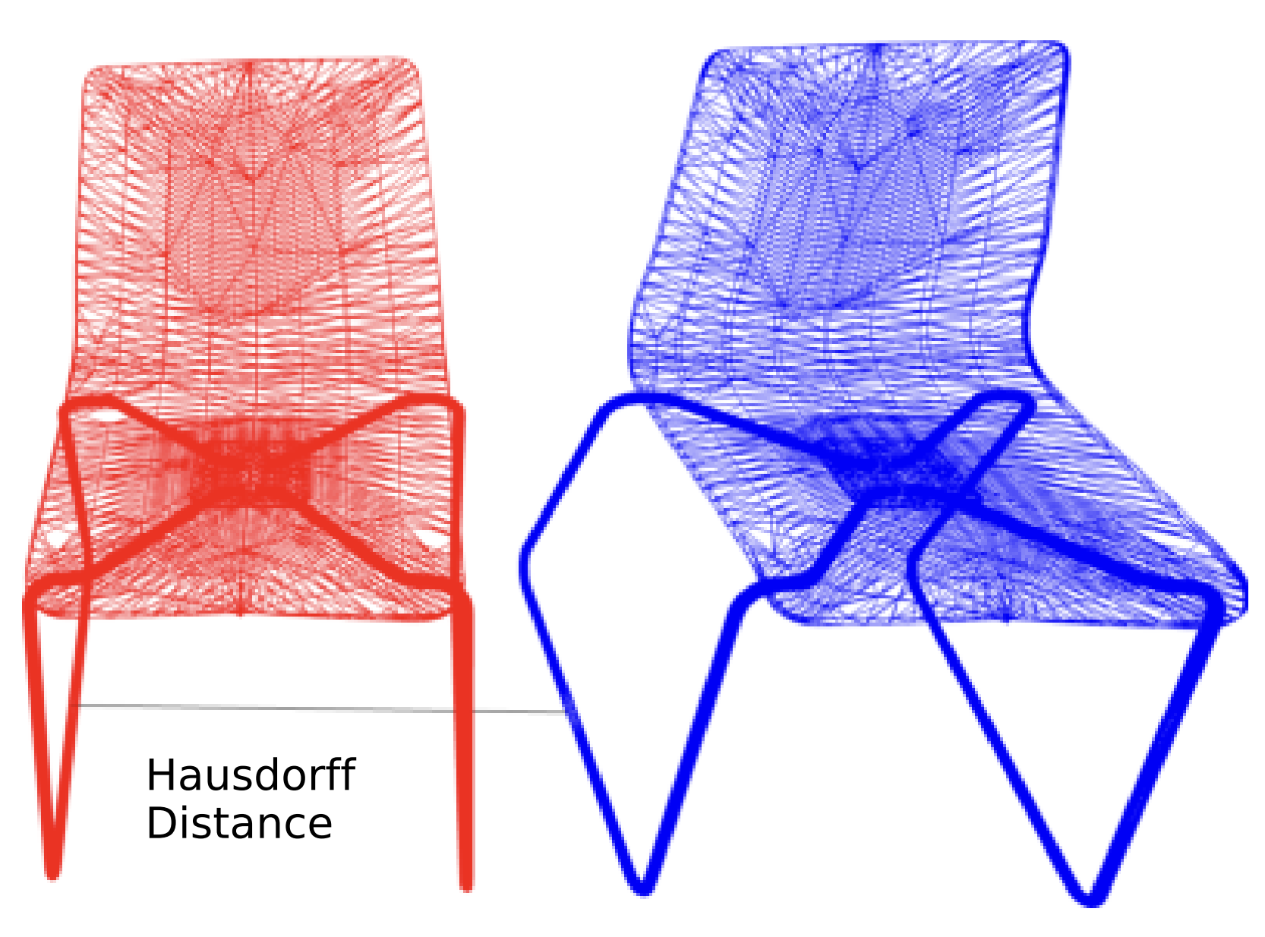

Applications of HD
Medical Imaging
Geospatial
CAD/Graphics
Evaluating the quality of segmentations in MRI scans by comparing ground truth to predicted boundaries.
Comparing LiDAR point clouds and analyzing moving object trajectories
Shape matching, mesh comparison, and similarity assessment for automated design.

Slide 61

Solving Hausdorff Distance
Definition: $\overset{⃑}{H}\left(A, B\right)=\max_{a∈A}\{\min_{b∈B}\{|\left|a,b\right||\}\}$
cmax ← 0 // Global Maximum Distance
for each a ∈ A do
cmin ← ∞ // Minimum Distance from point a
Double Loop
for each b ∈ B do
dist ← ||a, b||
cmin ← min(cmin, dist)
end for
cmax ← max(cmax, cmin) // Update Global Max
end for
Early Break
Nearest Neighbor
Breaking the inner loop early under a condition
Building an index over Points B to facilitate nearest neighbor search
Taha et al. An Efﬁcient Algorithm for Calculating the Exact Hausdorff Distance, TPAMI, 2015
Notes:
Following its mathematical definition, we will use a double loop to solve the HD
We can further optimize the inner loop, the first method is called early break; and the second is the nearest neighbor search.

Slide 62
General Purpose HD Algorithms
Early Break (EB)
Nearest Neighbor (NN)
Breaking the inner loop early if the current minimum cannot increase the global maximum.
No index overhead
Performance dynamics (break may not trigger)
Using a spatial index like KD-trees to avoid visiting all points by finding the closest neighbor directly.
Scalable and predictable performance
Indexing cost
cmax ← 0 // Global Maximum Distance
for each a ∈ A do
cmin ← ∞ // Nearest Neighbor Distance
for each b ∈ B do
dist ← ||a, b||
cmin ← min(cmin, dist)
if dist ≤ cmax then break // Early Break
end for
cmax ← 0
Index ← BuildSpatialIndex(B) // Build Index
for each a ∈ A do
nearest_b ← Index.NNSearch(a) // Offload to RT
dist ← ||a, nearest_b||
cmax ← max(cmax, dist)
end for
Essential NN search!
cmax ← max(cmax, cmin) // Update Global Max
end for

Slide 63



Original NN Search
Radius search from query point
$$P_{1}$$
$$P_{3}$$
r
Query
$$P_{2}$$

Slide 64

RT-accelerated NN Search
Inverse search
$$P_{1}$$
$$P_{3}$$
Query
Short Ray
$$P_{2}$$
Now, only consider the following distances:
Query → $P_{1}$
Query → $P_{2}$
Zhu, RTNN: accelerating neighbor search using hardware ray tracing, PPoPP, 2022
Notes:
Finding the point-box intersection is accelerated by the RT cores

Slide 65






Challenges of directly using an RT-backed library?
Intersection Overhead
Redundant Computation
Load Imbalance
Too many intersections can be a bottleneck, as they trigger frequently SM/RT core switches.
Existing libraries lack domain-specific pruning logic, causing unnecessary distance calculations.
Single-ray programming model handles intersections in serial, underutilizing GPU resources.

Slide 66
Intersection Overhead & Solution
Grouping Proximal Points
We partition the space with a uniform grid to group spatially close points into cells.
Create Minimum Bounding Rectangles (MBRs) enclose the points
Expand MBR corners by search radius r
We iterate the points in the MBR to maintain minimum distance
Reducing the boxes, so we have a smaller BVH and less intersections
Hit
Notes:
In the previous example, we map each point to an AABB, and this design results in many intersections, suffering from intersection processing overheads due to the swach between RT cores and SMs

Slide 67



Redundant Computation & Solution
$$a_{1}$$
cmax
NN Candidate
Pruning non-contribution points with distance estimators
All the points in an MBR can be pruned if the upper bound <= cmax (the current global distance)
None of points in the box help to increase the global maximum, so we don’t have to visit them
$$a_{2}$$
NN Candidate
Upper Bound <= cmax

Slide 68

Imbalanced Workload Challenge
Imbalanced Load & Limited Tools
Shader’s Thread
Introducing a uniform grid to partition points may result in a severely imbalanced grid, due to the nature of spatial datasets
RT shaders execute serially to process intersections. If a grid cell contains thousands of points (skewed data), the shader becomes a bottleneck.
Shader’s Thread
The points will be sequentially visited by the thread casting the ray to maintain local minimum distance
Synchronizations are not available for RT cores, so existing load-balancing methods cannot be used here to distribute workloads.

Slide 69
Solution to Imbalanced Workload
Two-tier Load Balance Strategy
The limitation of synchronizations suggests us that we can only address the LB issue within the CUDA kernel
Classified the cells into two tiers, heavy cells and lightweight cells according to its the number of points
Thread Block
RT Shader
Heavy Cell: Running EB algorithm with a thread block
Lightweight Cell: Follow the NN algorithm within the RT shader

Slide 70
Experimental Environment
Hardware Settings
CPU: Intel i9-12900
GPU: NVIDIA RTX 3090
Software: Optix 9 and CUDA 13
Implementations | Device | Notes
ITK | CPU | Insight Toolkit, a popular industry medical image processing tool
Implementations | Device | Notes
ITK | CPU | Insight Toolkit, a popular industry medical image processing tool
NN-KD | GPU | NN Search with KD-tree in CUDA
Implementations | Device | Notes
ITK | CPU | Insight Toolkit, a popular industry medical image processing tool
NN-KD | GPU | NN Search with KD-tree in CUDA
NN-Clover (ICS’25) | GPU | NN Search with Clover, a SOTA graph-based NN search library
Implementations | Device | Notes
ITK | CPU | Insight Toolkit, a popular industry medical image processing tool
NN-KD | GPU | NN Search with KD-tree in CUDA
NN-Clover (ICS’25) | GPU | NN Search with Clover, a SOTA graph-based NN search library
EB | GPU | Early Break implementation in CUDA
Implementations | Device | Notes
ITK | CPU | Insight Toolkit, a popular industry medical image processing tool
NN-KD | GPU | NN Search with KD-tree in CUDA
NN-Clover (ICS’25) | GPU | NN Search with Clover, a SOTA graph-based NN search library
EB (TPAMI’2015) | GPU | Early Break implementation in CUDA
RT-HDIST (Computer Graphics Forum’25) | GPU | The only HD work with RT cores (no pruning, no load balancing)

Slide 71
Datasets
Name | Type | # of Points | Skewness | Notes
BraTS | 400+ MRI Images | Avg 1.5M | Low | Multimodal Brain Tumor Segmentation Challenge
Name | Type | # of Points | Skewness | Notes
BraTS | 400+ MRI Images | Avg 1.5M | Low | Multimodal Brain Tumor Segmentation Challenge
Dragon | Graphics | 0.4M | Mid | The Stanford 3D Scanning Repository
AsianDragon | Graphics | 3.6M | Mid | The Stanford 3D Scanning Repository
HappyBuddha | Graphics | 0.5M | Mid | The Stanford 3D Scanning Repository
ThaiStatuette | Graphics | 4.9M | Mid | The Stanford 3D Scanning Repository
Name | Type | # of Points | Skewness | Notes
BraTS | 400+ MRI Images | Avg 1.5M | Low | Multimodal Brain Tumor Segmentation Challenge
Dragon | Graphics | 0.4M | Mid | The Stanford 3D Scanning Repository
AsianDragon | Graphics | 3.6M | Mid | The Stanford 3D Scanning Repository
HappyBuddha | Graphics | 0.5M | Mid | The Stanford 3D Scanning Repository
ThaiStatuette | Graphics | 4.9M | Mid | The Stanford 3D Scanning Repository
USCounty | Geospatial | 9.4M | High | US County Boundaries
USZipcode | Geospatial | 43.9M | High | U.S. ZIP Code Areas
Lakes | Geospatial | 301.7M | High | Boundaries of water areas, worldwide
Parks | Geospatial | 403.7M | High | Boundaries of parks or green areas, worldwide
USWater | Geospatial | 22.8M | High | Detailed Water Bodies in the United States
USCensus | Geospatial | 52.3M | High | US Census Populated Place Areas
These are the frequently used datasets in their domains, all available online

Slide 72
Main Results - MRI Images Dataset
  X-HD is our work that incorporates the above optimization techniques, including grid, pruning, and load balancing.
  The datasets have low skewness & medium number of points
  We plot the running time distribution
  4.80X average speedup over ITK
  16.10X average speedup over RT-HDIST
  4.99X average speedup over NN-KD
  8.55X average speedup over NN-Clover
  5.35X average speedup over EB
  X-HD is consistently faster than all baselines

Slide 73
Main Results - Graphics
  Graphics datasets have medium skewness and large volume of points (0.4M~4.9M)
36.72X average speedup over RT-HDIST
172.40X average speedup over NN-KD
12.43X average speedup over NN-Clover
1.73X average speedup over EB

Slide 74
Main Results - Geospatial
  Graphics datasets have high skewness and very large number of points, 9M~400M
13.73X average speedup over NN-KD
23.44X average speedup over NN-Clover
4.68X average speedup over EB

Slide 75
Takeaways on RT-accelerated Spatial Function
Directly using RT cores or RT-based NN solutions for HD does not work well.
To maintain consistently high performance, we need to reduce intersections, improve load balancing, and eliminate unnecessary workloads.
X-HD achieves its speed by leveraging both CUDA cores and specialized RT cores on modern GPUs.
Its high performance across diverse workloads comes from combining hardware acceleration with domain-specific optimizations.

Slide 76
Chapter 0: Introduction
Chapter 1: Ray-tracing Meets Spatial Databases
Chapter 2: Ray-tracing Fundamentals
Chapter 3: RT for Spatial Join
Chapter 4: RT for Spatial Indexing
Chapter 5: RT for Spatial Functions (Case Study: Hausdorff Distance)
Chapter 6: RT in Action: Integrating RT into SedonaDB
Conclusion: Summary & Key Takeaways
Content

Slide 77

Apache SedonaDB: Treats Spatial Data as a First-class Citizen
Spatial analytics require specialized architectures
  Support for geometry/raster types
  CRS Propagation & Tracking, e.g., avoid joining two tables with different CRS
  Query optimizations (heuristic spatial join) and spatial data indexing
  Pythonic and SQL interfaces + APIs for R and Rust
  Out-of-the-box single-node OLAP DB
  Blazing fast
  Built on top of Apache DataFusion
Apache
SedonaDB
Notes:
Apache SedonaDB: a purpose-built OLAP engine for high-performance spatial analytics on a single node.
Built on Apache DataFusion, treating geospatial data as a first-class citizen.
Spatial indexing, spatial statistics, CRS tracking, Arrow format no Ser/Deser overhead, Spatial aware heurist based query optimization

Slide 78

SedonaDB is Fast, But Not Enough
Exponential growth of geospatial data
  Rich data sources: Mobile devices, Satellite, LiDAR…
  Moving objects - constantly updating
  Need fast query response, otherwise, outdated results
Single node still has very limited power!
A spatial query is significantly more compute-expensive than a regular SQL
  Complex data types (geometries) vs scalars
  Expensive predicates vs regular boolean expr.
  Multi-dim index (R-tree) vs single-dim (B-tree)
Spatial join is the major performance bottleneck
  Following the “Filter-and-Refine” paradigm
  Both can be performance bottlenecks
Example: Dynamic Driver Dispatch for Food Delivery
-- Finding all drivers in downtown
SELECT drivers.driver_id
FROM delivery_zones -- City zones in polygons
, drivers -- The latest driver positions in Points
WHERE
-- Is the driver (point) within the delivery zone (polygon)?
ST_Contains(delivery_zones.geom,
drivers.location)
AND delivery_zones.zone_name = 'Downtown';

Slide 79
GPU Acceleration for Spatial? Does Not Work Well!
GPUs are getting powerful
  High memory bandwidth (H100, ~3TB/s)
  High memory capacity (B300, 288GB)
  Getting heterogeneous (CUDA cores, Tensor cores, RT cores, hardware compression, unified memory…)
  Becoming affordable (previous gen.)
Pioneer & Emerging GPU-accelerated databases
  MapD (Heavy.ai), BlazingSQL, RateupDB, Theseus
  SQLRealm, Kinetica, PG-Strom, cuDF, Sirius
Execution patterns of spatial queries are not GPU-friendly
  Heavily rely on a spatial index (e.g., tree) to reduce search space
  Traversing a tree requires point-chasing
Tree traversal challenges on the GPU
  Branch divergence
  Stack management overhead
  Random memory access
N_{A}
N_{B}
N_{D}
N_{E}
N_{C}
a Bounding Volume Hierarchy (BVH) tree
Logical Pointers
Nodes
N_{A} | N_{B} | N_{C} | N_{D} | N_{E}
Boxes
A | B | C | D | E
Memory Layout

Slide 80


Graphics and Spatial are highly relevant
 | Spatial Domain | Graphics Domain
Example
Data | 2D Coordinates | 3D Coordinates
Geometry Primitives | Point, Line String, Polygons, Bounding Box (Vector data) | Triangle, Bounding Box
Operations | Evaluating geometry relations | Finding intersections (Ray-tracing rendering)
Given the high relevance between the two domains
Can we exploit the existing hardware units on the GPU to accelerate spatial queries?
https://www.lix.polytechnique.fr/~maks/Verona_MPAM/TD/TD2/
https://www.facebook.com/photo?fbid=801112259739831&set=a.127525900431807

Slide 81
Ray-casing for Spatial Queries
A complex geometry is composed of points, line segments, and rings
Using different forms of rays to simulate them
  Building a BVH over the boundary of one side of geometries
Point-MBR Containment Test
MBR-MBR Intersection Test
Point
LineString
Polygon
Short Ray
Segment Rays
Boundary Ring Rays
Short Ray-AABB Intersection Test
Diagonal Ray-AABB Intersection Test
Notes:
A complex geometry is composed of points, line segments, and rings
We can always decompose a geometry into these basic components
RT-accelerated BVH serves as a spatial index
Using AABBs to enclose line segments for one side of the spatial join
Using different forms of rays to simulate them
Casting rays for another side of the join to find intersections

Slide 82
Built Upon Our Previous Research Prototypes
We have addressed all RT repurposing problems
Spatial Joins
  RayJoin: RT-accelerated spatial joins and polygon clipping (ICS’24)
General Spatial Index
  LibRTS: Repurposing RT cores as a general-purpose spatial index (PPoPP’25)
Spatial Metrics
  X-HD: Using RT cores to compute Hausdorff distance (ICS’26)
However, we have to address several engineering challenges

Slide 83

The Systematic Challenges in RT-acceleration
Data Format Mismatch
  SedonaDB adopts Well-known Binary (WKB) to efficiently store geometries
  But not good for computation – does not support random geometry access
  Need to design a compact & GPU-friendly geometry format
Indexing Scalability
  We need a table-level index for the filter stage
  May also need a row-level index to speed up queries over complex geometries
  Huge number of small indexes leading to index build-up overhead
Combinatorial Complexity
  There are tens of spatial predicates X 7 geometry types (each side of join)
  ~500 combinations of operators! Huge development efforts and maintenance costs
  Can we avoid writing 500+ CUDA kernels?
https://help.arcgis.com/en/geodatabase/10.0/sdk/arcsde/concepts/geometry/representations/binary.htm

Slide 84
RayBooster: A Suite of Solutions to Accelerate SedonaDB
The first integration of RT-core acceleration into a production database system
Pluggable Accelerator: Offload only the most compute-intensive spatial joins to GPUs
Architecture Overview:
Output
Input
Matched Indices
WKBs &
Predicate
RT Shaders
NVIDIA OptiX
Storage Layer
ParallelWKBLoader
Bounding Boxes
WKB Parser
Thread Pool
Type Analyzer
Transfer Manager
Refined Pairs
Indexing Layer
Point Query
Range Query
Point Array /
MultiPoint Array
Candidate Pairs
LineString Array /
MultiLineString Array
Refinement Layer
CUDA Refiner
RT Refiner
Polygon Array /
MultiPolygon Array
Geometries

Slide 85

GPU-friendly Geometry Format
CSR-like format to represent all types of geometries
  Hierarchical offset arrays and a vertices array
  Features → Parts → Rings → Vertices
  Compact storage and facilitate coalesced memory access
Converting WKBs to this format on-demand
  WKBs are stored in Arrow arrays
  Parallel conversion on the CPU for incoming queries
  Only keep geometries on device memory to reduce memory usage

Slide 86
Accelerating the Filter Stage with RT cores
The filter stage finds geometries that potentially have intersections
  Using MBRs, approximate the outline of geometries
  Point query: MBR-Point intersection test
  Range query: MBR-MBR intersection test
Maps spatial index search to ray casting operations:
  Point Queries: Cast short rays from the probe points.
  Range Queries: Dual-pass diagonal/anti-diagonal ray casting.
RT Acceleration
BVH Tree
Build-side
INTERMEDIATE
NODES
Node 1
Probe-side
② Cast Rays
from Geometry Outlines
Feature ID | Geometry
P₁
P₂
P₃
P₄
Feature ID | Geometry
Q₁
Q₂
Q₃
① BVH over
Feature MBRs
Node 2
Node 3
Node 4
Node 5
Node 6
Node 7
LEAF
NODES
Q₁
Q3
Q₂
Candidate Pairs
P₁
P₂
P₃
P₄
(P₁, Q₁) | (P₁, Q₂) | (P₄, Q₃)
③ Write back intersections

Slide 87








Refinement Stage by Ray-casting
Geometry can also be very complex (thousands of line segs)
  For example, PreparedPolygon in the GEOS library
Requiring fine-grained indexes, requring a BVH for each geometry
  Building millions of tiny BVHs degrades performance due to memory alloc./sync. overhead.
Z-Stacking: Places 2D geometries at distinct Z-planes in a single 3D scene, eliminating multi-BVH allocation and synchronization overhead.
RT Acceleration
Candidate Pairs
$$z$$
(P₁, Q₁) | (P₁, Q₂) | (P₄, Q₃)
4
P₁
① Extract Unique Feature IDs
Q₁
Query Side
Feature ID
Q₂
x-y plane
Q₁
Indexed Side
③ Cast rays from geometry elements
Start
② BVH over Line Segs.
Q₃
Q₂
1
P₄
P₁
Stop
$$y$$
x-y plane
P₄
Q₃
$$O$$
Original x-y coordinates of the features
$$x$$
④ Calculate Intersection Matrices
Candidate Pairs | DE-9IM
(P₁, Q₁)
(P₁, Q₂)
(P₄, Q₃)
$$\begin{matrix}F & F & 2 \\ F & F & 1 \\ 0 & F & 2\end{matrix}$$
Intersection Mask
&
$$\begin{matrix}0 & F & 2 \\ F & F & 1 \\ F & F & 2\end{matrix}$$
&
$$\begin{matrix}T & T & ∗ \\ T & T & ∗ \\ ∗ & ∗ & ∗\end{matrix}$$
&
$$\begin{matrix}2 & 1 & 2 \\ 1 & 0 & 1 \\ 2 & 1 & 2\end{matrix}$$
(a) Polygons being Indexed by the BVH
(b) Scene of Indexed Polygons and Rays from Query Side
(c) Cast Rays from Query Points and Polygon
(d) Filter out entries not satisfying the given predicate

Slide 88






Taming Combinatorial Complexity
Spatial joins have ~500 geometry-predicate combinations.
Hardcoding GPU kernels is unmaintainable.
Solution: RelateEngine
  Computes the Dimensionally Extended 9-Intersection Model (DE-9IM) as a universal topological descriptor.
  Ray casting simulates geometric vertices and line segments to find exact interior/boundary intersections.
  A single code path resolves arbitrary spatial predicates via logical mask matrices.
  Evaluates the universal DE-9IM topological matrix via ray casting → Reduced to ~20 device functions
Indexed Side
Query Side
Hole
AABB
Ray
Hit Point
Intersection Mask
Query Side
Indexed Side
I
B
E
Start
$$\begin{matrix}T & T & ∗ \\ T & T & ∗ \\ ∗ & ∗ & ∗\end{matrix}$$
I
$$\begin{matrix}∗ & ∗ & ∗ \\ ∗ & ∗ & ∗ \\ ∗ & ∗ & ∗\end{matrix}$$
I: Interior
B: Boundary
E: Exterior
B
Q₁
E
&
&
&
Q₂
Stop
Q₁
Q₂
Q₃
$$\begin{matrix}F & F & 2 \\ F & F & 1 \\ 0 & F & 2\end{matrix}$$
$$\begin{matrix}0 & F & 2 \\ F & F & 1 \\ F & F & 2\end{matrix}$$
$$\begin{matrix}2 & 1 & 2 \\ 1 & 0 & 1 \\ 2 & 1 & 2\end{matrix}$$
PIP by Casting Horizontal Rays and Counting Intersections
Polygon Intersection Test by Casting Rays along Boundary
Intersection Matrices for Q1, Q2, and Q3 with Intersection Predicate)
https://dev.luciad.com/portal/productDocumentation/LuciadFusion/docs/articles/guide/geometry/de-9im.html

Slide 89
SedonaDB Outperforms CPU-based DBs
Baselines: Popular OLAP and OLTP DBs with spatial extensions
Benchmark: Sedona SpatialBench (similar to TPC-H)
Query | Description
Q2 | Count trips starting within Coconino County zone
Q4 | Zone distribution of top 1000 trips by tip amount
Q6 | Zone statistics for trips within a 50km radius of Sedona city center
Q9 | Duplicate/overlap detection via Intersection over Union
Q10 | Zone statistics for trips starting within each zone
Q11 | Count trips that cross between different zones
Name | Category | Device
DuckDB | OLAP DB | CPU
GeoPandas | Python Library | CPU
PostGIS | Spatial Extension to OLTP DB | CPU
SedonaDB | OLAP DB | CPU

Slide 90
GPU Evaluation Settings
Evaluated Products:
  SedonaDB is already faster than DuckDB, GeoPandas, and PostGIS, so we don’t show them in the following evaluations
  GPUs: Desktop and datacenter-grade GPUs
GPU | RT Cores | FP64 Perf. | VRAM (Bandwidth) | GPU (RAM) | Platform Unit Price
RTX 3090 | 2nd Gen (82) | 556.0 GFLOPS | 24GB (936 GB/s) | i9-12900 (64GB) | Workstation
GPU | RT Cores | FP64 Perf. | VRAM (Bandwidth) | GPU (RAM) | Platform Unit Price
RTX 3090 | 2nd Gen (82) | 556.0 GFLOPS | 24GB (936 GB/s) | i9-12900 (64GB) | Workstation
A10 | 2nd Gen (72) | 976.3 GFLOPS | 24GB (600 GB/s) | 8 vCPUs (32GB) | AWS g5.2xl $1.21/hr
GPU | RT Cores | FP64 Perf. | VRAM (Bandwidth) | GPU (RAM) | Platform Unit Price
RTX 3090 | 2nd Gen (82) | 556.0 GFLOPS | 24GB (936 GB/s) | i9-12900 (64GB) | Workstation
A10 | 2nd Gen (72) | 976.3 GFLOPS | 24GB (600 GB/s) | 8 vCPUs (32GB) | AWS g5.2xl $1.21/hr
L4 | 3rd Gen (60) | 473.3 GFLOPS | 24GB (300 GB/s) | 8 vCPUs (32GB) | AWS g6.2xl $0.98/hr
GPU | RT Cores | FP64 Perf. | VRAM (Bandwidth) | GPU (RAM) | Platform Unit Price
RTX 3090 | 2nd Gen (82) | 556.0 GFLOPS | 24GB (936 GB/s) | i9-12900 (64GB) | Workstation
A10 | 2nd Gen (72) | 976.3 GFLOPS | 24GB (600 GB/s) | 8 vCPUs (32GB) | AWS g5.2xl $1.21/hr
L4 | 3rd Gen (60) | 473.3 GFLOPS | 24GB (300 GB/s) | 8 vCPUs (32GB) | AWS g6.2xl $0.98/hr
L40S | 3rd Gen (142) | 1.43 TFLOPS | 48GB (864 GB/s) | 8 vCPUs (64GB) | AWS g6e.2xl $2.24/hr
GPU | RT Cores | FP64 Perf. | VRAM (Bandwidth) | GPU (RAM) | Platform Unit Price
RTX 3090 | 2nd Gen (82) | 556.0 GFLOPS | 24GB (936 GB/s) | i9-12900 (64GB) | Workstation
A10 | 2nd Gen (72) | 976.3 GFLOPS | 24GB (600 GB/s) | 8 vCPUs (32GB) | AWS g5.2xl $1.21/hr
L4 | 3rd Gen (60) | 473.3 GFLOPS | 24GB (300 GB/s) | 8 vCPUs (32GB) | AWS g6.2xl $0.98/hr
L40S | 3rd Gen (142) | 1.43 TFLOPS | 48GB (864 GB/s) | 8 vCPUs (64GB) | AWS g6e.2xl $2.24/hr
A100 | SW Emul. | 9.75 TFLOPS | 40GB (1.56 TB/s) | EPYC 7H12 (472GB) | Ohio Super Computing
GPU | RT Cores | FP64 Perf. | VRAM (Bandwidth) | GPU (RAM) | Platform Unit Price
RTX 3090 | 2nd Gen (82) | 556.0 GFLOPS | 24GB (936 GB/s) | i9-12900 (64GB) | Workstation
A10 | 2nd Gen (72) | 976.3 GFLOPS | 24GB (600 GB/s) | 8 vCPUs (32GB) | AWS g5.2xl $1.21/hr
L4 | 3rd Gen (60) | 473.3 GFLOPS | 24GB (300 GB/s) | 8 vCPUs (32GB) | AWS g6.2xl $0.98/hr
L40S | 3rd Gen (142) | 1.43 TFLOPS | 48GB (864 GB/s) | 8 vCPUs (64GB) | AWS g6e.2xl $2.24/hr
A100 | SW Emul. | 9.75 TFLOPS | 40GB (1.56 TB/s) | EPYC 7H12 (472GB) | Ohio Supercomputer Center
H100 | SW Emul. | 33.45 TFLOPS | 94GB (3.36 TB/s) | Xeon 8470 (1TB) | Ohio Supercomputer Center
Name | Category | Device
PGStrom | GPU support for PostGIS (The only open-source with GPU) | GPU (SMs)
SedonaDB | OLAP DB | CPU
RayBooster | GPU support for SedonaDB | GPU (RT Cores)

Slide 91








Performance Summary
Latency-sensitive queries: slightly faster or comparable to SedonaDB
Heavy joins (Q10, Q11) compared to the best baseline
  SF=1, up to 4.66X(3090), 3.74X(L4), 3.89X(L40S), 2.92X(A10), 3.63X(A100), and 4.52X(H100)
  SF=10, up to 8.24X (3090), 5.93X(L4), 6.66X(L40S), 4.78X(A10), 6.74X(A100), and 9.68X(H100)

Slide 92

Cost-Effectiveness
Cheapest GPU (L4) yields the lowest cost g6.2xlarge
  Example: Q10
  CPU: $0.00372
  GPU: $0.001524
  59.02% Cost Reduction and 5.93X Speedup compared to SedonaDB on the CPU
Overall cost reduction: 38.11% by running all queries

Slide 93
Key Takeaways on RT-accelerated SedonaDB
Status of SedonaDB today
Accelerating full-fledged spatial databases face significant systematic challenges.
  Data format mismatch
  Indexing overhead
  Combinatorial complexity
Production-Ready: RayBooster bridges the architectural gap, fully integrated into Apache SedonaDB.
Results: Highly efficient and cost-effective engine for large-scale spatial analytics.

Slide 94
Chapter 0: Introduction
Chapter 1: Ray-tracing Meets Spatial Databases
Chapter 2: Ray-tracing Fundamentals
Chapter 3: RT for Spatial Join
Chapter 4: RT for Spatial Indexing
Chapter 5: RT for Spatial Functions (Case Study: Hausdorff Distance)
Chapter 6: RT in Action: Integrating RT into SedonaDB
Conclusion: Summary & Key Takeaways
Content

Slide 95
Summary & Key Takeaways
RT-cores make BVH traversals superfast
We have successfully repurposed this device to accelerate Spatial Databases by targeting the following topics:
  Spatial Joins Techniques: RayJoin
  General-purpose Spatial Index: LibRTS
  Spatial Function – Hausdorff Distance: X-HD
  RT-acceleration in SedonaDB: RayBooster
Our research prototypes have been merged into the production system SedonaDB
  This low-latency spatial database plays unique roles for interactive users
  For details, you are welcome to attend Liang’s presentation on RayBooster this afternoon
SedonaDB’s software link: https://github.com/apache/sedona-db
  Please send us your feedback for us to further improve the system

Slide 96
BVH Tree Traversal on the GPU
Key Bottlenecks:
  Pointer Chasing & Cache Thrashing: Tree nodes are scattered in memory. Following child pointers results in random, non-coalesced memory accesses, causing massive latency stalls.
  Thread Divergence: GPU threads run in lockstep (SIMT). If one thread's ray goes deep into the tree while another thread's ray misses immediately, the entire group of threads stalls waiting for the slowest one (warp execution divergence).
  Stack Management Overhead: GPUs lack hardware-managed stacks. Simulating a stack in software (using registers or local memory) causes high register pressure and spilling.
  Instruction Bloat: Most instructions are wasted on traversal book-keeping (stack push/pop, pointer math) instead of actual geometry intersection math.
A
1
Ray 1 | Ray 2 | Ray 3 | Ray 4
B
A
A
A
A
3
C
D
C
C
C
C
2
4
E
B
B
E
E
D
B
D
B

Slide 97
Challenge 2: Mapping Spatial Predicates to Rays
The Complexity of Spatial Relations
  - Spatial databases support complex standards (like DE-9IM) to check topological relations: Contains, Within, Intersects, Touches, Crosses, Overlaps.
  - Graphics rendering only cares about the 'intersect' (line hitting triangle) relation.
The Formulation Challenge:
  - Point-in-Polygon (PIP) Queries: How to verify point containment? We must shoot rays from the query point and count boundary crossings (odd-even rule).
  - Line-Segment Intersection (LSI) Joins: How to join sets of segments? We must wrap one set in AABBs and trace the other set as rays, reporting all hits.
  - Range and Polygon Overlay Queries: Requires mapping boxes/polygons into complex ray configurations that can query a BVH.
  - Each query type requires configuring custom ray origins, directions, lengths, and custom shaders (AnyHit, ClosestHit) on the GPU.

Slide 98
Miss
FP32
FP64

